Slide 1








2032 exercise in COP#2:
Vision and strategies

Slide 2
2032 exercise
This exercise was done during COP#2.
The proposal was the following:
Imagine you are in the year of 2032 — 10 years ahead of today.
What is your coalition celebrating? What have you achieved in foundational learning in your country?
How did you achieve this outcome in foundational learning in your country? Which were your strategies?
Were there challenges to reach these results along the 10 years?
Groups were interviewed in a news TV programme in 2032 to talk about their success case.

Slide 3
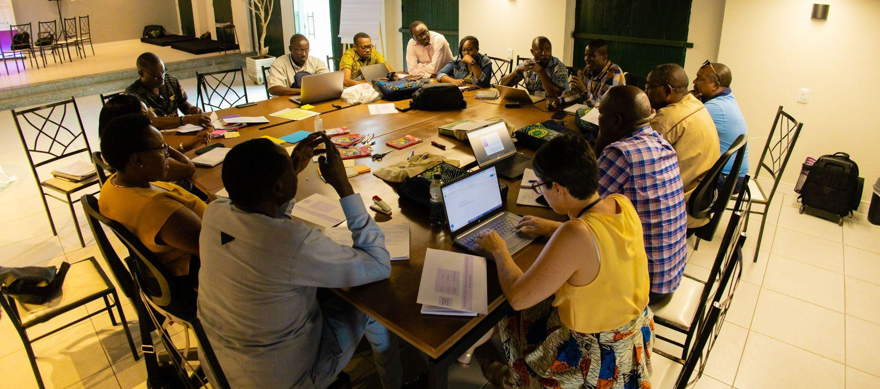
Kenya

Slide 4
 | Group 1 | Group 2
 | 10 years ago, the government dictated everything, for e.g., how much money goes to textbooks etc. In 2032, decisions are being made by teachers, at the school level. Teachers’ integrity level has grown, they have changed their mindset: they are making decisions based on the needs/ interest of the learners/ school/ community, and not based on their own personal interest. That change was bottom up and got to the policymakers as well. | 10 years ago, most of our learners could not read. We envisioned that, by the time our learners get to grade 3, above 95% of them should be able to read.
 | Between 2022-2032, policies have been implemented to allow decisions to be made by teachers, at the school level. We built the capacity of school leaders and teachers. We helped them interpret guidelines and policies coming from the Ministry of Education, so that they were able to make sense of these documents. We built the capacity Monitoring & Evaluation Dept. from the Ministry of Education, so that there was constant monitoring of the process & feedback between top and down. We faced the challenge of people not following the need/interest of the learner. But over time, we saw that change of mindset. | We identified the challenges that led to the failure of most learners not being able to read as they get to grade 3. Learning environment was not conducive for learners to learn (lack of infrastructure). Lack of quality, relevant instructional materials. Foundational learning is very activity-based, and that requires a lot of materials. Materials had to be diverse. For e.g. digital learning resources develop many skills. Inadequate teacher support. Inadequate funding at the foundational level. Teachers were supported so that they could make learning materials from their environment. There reduced unnecessary costs that came with the expectation that the government should fund all learning resources. We developed policies/ strategies so that the ratio between teachers and learners was in line with what is recommended globally. Number of teachers was critical.
Vision for 2032
Strategies to get there
Notes:
Objectives are clear, relevant and feasible? Contents and methodological approach are aligned with objectives?

Slide 5
 | Group 3
 | We are celebrating today, 10 years down the line, that foundational learning is a way of life for our teachers. Our journey begun after reports had indicated that by grade 3 most of our learners do not read or write. I have been just told by our county officials that they are going to invite a team from Sobral to come and witness the success we also had here.
 | Among other things, we worked, we worked on attitude change of our teachers. Teachers now believe that all learners must read. We have also worked very hard to ensure that teachers are equipped with assessment capacity, to assess for learning. Our classrooms, you should see them! They are well-resourced classrooms for both teachers and learners.The environment motivates our teachers and our learners. We are using resources in the classrooms that are quality-assured. We have also made sure that our teachers are accountable and well supported. Our teachers are the ones who set the performance targets, given the environment they are working in.
Vision for 2032
Strategies to get there
Notes:
Objectives are clear, relevant and feasible? Contents and methodological approach are aligned with objectives?

Slide 6
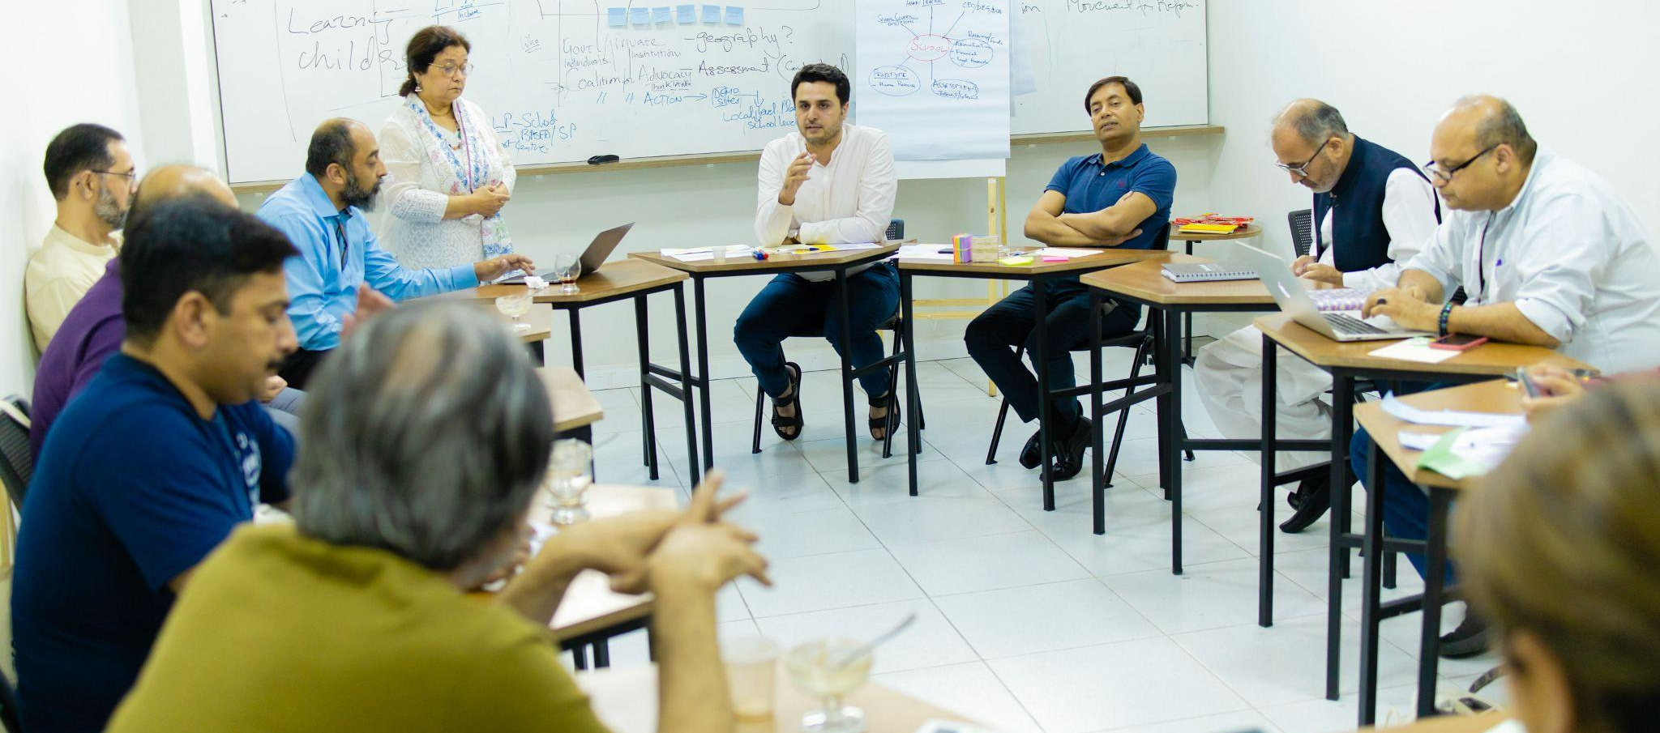
Pakistan

Slide 7
 | Group 1 | Group 2
 | It all started for us back in Sobral, 10 years ago. When we started visiting those schools, we realised that we can do something about foundational learning in Pakistan as well. We have good literacy and numeracy as compared to where we were before. We are very proud to have extended our interventions across all 4 provinces in Pakistan, in multiple counties, multiple villages. | I am representing Punjab. The whole country progressed on education, and in Punjab as well. Learning levels of science and mathematics have been remarkably improved. Our children are scoring very good scores in PISA, especially in mathematics. Now our our workforce is working globally and fulfilling the needs of the country. We have achieved 100% of gender parity. We have way less out-of-school children. Access issues are resolved. Net enrolment rate is 98%. We have seen a school meal programme in Sobral. We have achieved a very good level of nourishment. We have been able to provide one meal to all children in Punjab. There is a good learning environment. 1/3 of the children are going to school in the public-private partnership mode.
 | We went for tiny interventions across 4 provinces to build model villages. We utilised villages to validate our model and expand it to the larger province. One of the keys we achieved: we have empowered the head teachers. There is no political hiring any more, we are hiring on merit across Pakistan. We are constantly monitoring, doing assessments to ensure that where we are lagging can improve
Vision for 2032
Strategies to get there
Notes:
Objectives are clear, relevant and feasible? Contents and methodological approach are aligned with objectives?

Slide 8
 | Group 3
 | Going back to our first visit to Sobral, at that time things were looking impossible. After our pilot which we conducted in Ghotki and Shikarpur, after those amazing results, the government decided to scale it up. We started successfully scaling up that pilot into other districts of our province. The communities supported us. There was the kind of pressure and ownership which we saw in Sobral.
 | We created a true movement. We have with us parliamentarians who are holding relevant portfolios, civil servants, civil society, students, teachers, parents. Our indicators are teachers-driven with clear targets. There are clear school implementation plans for teachers. We have successfully implemented teacher licensing policies. Quality of teachers has drastically improved. An area that was challenging was fund flows management. But base budgets have been assured to schools to meet the targets. Our plans are research-based. One factor we learned from the Brazilian experience is collaborating with universities. Academia is on board with us, and we requested for them to conduct research on many topics.
Vision for 2032
Strategies to get there
Notes:
Objectives are clear, relevant and feasible? Contents and methodological approach are aligned with objectives?

