Slide 1

Foundational Literacy and Numeracy
South to South Community of Practice
Kenya
25th October 2022

Slide 2
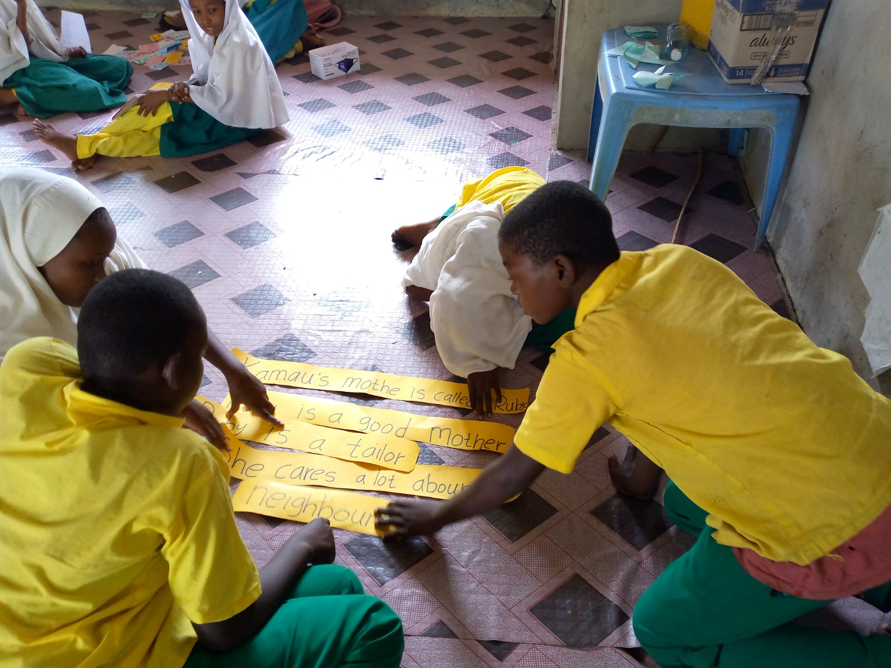
Context
Foundational literacy is the ability to read/listen with comprehension. Encompasses skills such as:
  letter identification;
  reading words; and
  reading/listening with fluency.
Foundational numeracy encompasses acquisition of number sense:
  ability to identify numbers;
  discriminate between numbers;
  find missing numbers; and
  solve operation & word problems.

Slide 3
Context
Pre-COVID-19:
  53% (607 million) of children in low and middle-income countries (LMICs) had acquired the reading competencies expected of them at age 10 years (suffered learning poor);
  86%(202) million children aged 10 years in Sub-Saharan Africa suffered from learning poverty.
As a result of COVID-19:
  This proportion is projected to have increased to 70% globally; and
  Up to 89% in Sub-Saharan Africa.
(https://www.worldbank.org/en/news/press-release/2022/06/23/70-of-10-year-olds-now-in-learning-poverty-unable-to-read-and-understand-a-simple-text)

Slide 4
Context - Kenya
In Kenya, assessment data showing the extent of learning poverty, from various sources is summarized as follows:
NASMLA, 2020:
47% of those in Grade 3 did not meet the reading expectations in English; compared to 41% in Kiswahili.
32% of those in Grade 3 had not attained minimum expectations in numeracy.
Uwezo, 2020:
During the school closures, only 22% of the school-going children accessed remote learning platforms.
Majority of those who accessed were from private schools and in urban areas.

Slide 5
Context
Uwezo, 2021:
40% of learners in grade 4 at least met expectations in reading a Grade 3 appropriate English text.
49.5% of learners in grade 4 at least met expectations in solving a Grade 3 appropriate numeracy problems.
1 in 5 girls with disabilities dropped out of school due to COVID-19 enforced school closures.
30% of children of pre-school age are out of school.
30% of children enrolled in ECDE centres are over-age.
Kirinyaga County was among the top five counties in enrolment, with less than 5% of the school-aged children being out of school.
This means that a school-based intervention is well placed to remedy learning poverty among the children in the county, hence its choice for the pilot project.

