Slide 1








Coalition planning in Pakistan

Slide 2
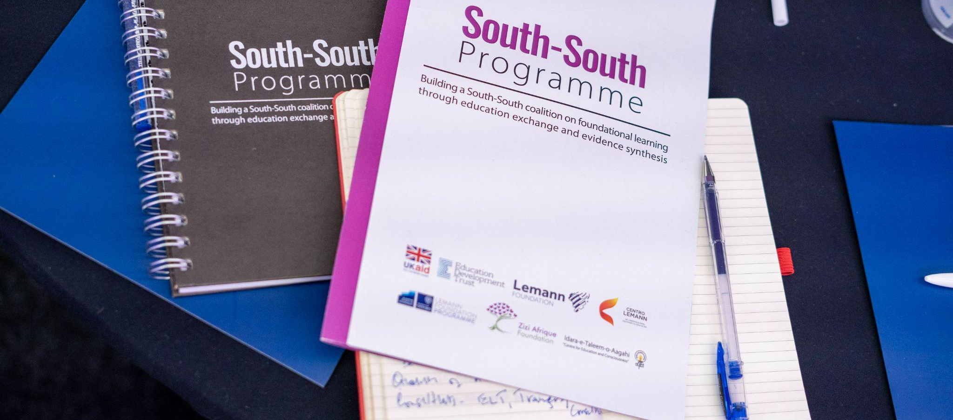
Planning the coalition work

Slide 3
HELPFUL
HARMFUL
STRENGTHS
(inside coalition)
WEAKNESSES
(inside coalition)
There are senior decision maker bureaucrats (7) in the group who know the system well & can change /improve foundational learning at system level
There are 8 CSO/Industry partners who are strong leaders /influencers and have been on the cutting edge of innovations, policies and reforms - some invested deeply in Foundational Learning assessments and actions - leadership and teachers training that produces results
Of the latter there are 2 who are part of communications/actions campaigns they can provide key messages for the interventions
the bureaucrats that have led the SS P- local level action group for FL have been amazing in KP, Punjab and Sindh
Too many rival claims on time of senior decision maker fellows, due to floods and its aftermath, or generally too many assignments to give dedicated time for the fast paced South South- senior teams may not find time for the SS-P in spite of best intentions
Lacking urgency to agree on the way forward for the interventions that will create public goods and sustain them in the short period of time
Slow in documenting the process as a critical anchor document on foundational learning and its crisis in Pakistan
Few extended Fellows are active -few clear and with delegated powers
CSOs are also very busy - find time with difficulty
INTERNAL
OPPORTUNITIES
(external to coalition)
THREATS
(external to coalition)
There is a huge nationwide urgency -and ASK by the public about what ails the education system -what can people do to accelerate the pace of remedies/reform and transformation
Goverments are in a ‘reform at scale mood’ especially in provinces majorly affected by the floods (in Sindh 60% of schools are fully/partially destroyed - urgency in the air
Readiness and responsiveness to education transformation is everywhere in search of new ways of coming together for Education Action- who will cast the first stone? what are the critical solutions
Digital Solutions/distance learning opportunities - with partners
Pakistan a success story of public private partnerships to build on
Education still with very poor /chronically low budgets less than 2% of GDP expenditures
Other crises will supersede education in terms of attention: the policial mess/crisis; the emergency crisis of infrastructure damage, the climate change crisis - how can education get attention amidst rivals unless it also piggy backs on them ?
Project mode mentality - doing little things that don’t add up and it will take decades for Pakistan to catch up as the metrics/data shows flat trends that will only go down if not attended to urgently
Coalitions do not stand the test of time may fall apart
Elections are around the corner - all senior bureaucrats may be transferred by April 2023
EXTERNAL
Notes:
Objectives are clear, relevant and feasible? Contents and methodological approach are aligned with objectives?

Slide 4
COALITION OBJECTIVE
All Children Learning by Grade 3
STRATEGIES
Formation of Village Clusters in Provinces, Data Collection as evidence
Formation of local groups as Village Councils
Drafting Modules for trainings of teachers and local groups on Foundational Learning
FL Recovery Interventions via Local Groups/Village Councils
Drafting of a collective White Paper on FL
Formation of multiple local and transnational networks to sustain coalitions
KEY ACTIONS
Form 3-4 village clusters in provinces as prototype labs
Map evidence of foundational learning gaps in each cluster
Provide data for remediation
Each village cluster to have One local Village Council formed after consensus of S-S Fellows to sustain the interventions and make them localized
Non-State Actors in the Fellowship like SoE, ITA, Tabadlab, I-SAPS and TCF to draft modules for trainings for head-teachers, teachers and also Village Councils
TaRL camps to be set up through the empowerment of the local Village Council Groups and teachers
Other structured remediation tools from TCF to local groups
As a global public good from Pakistan which benefits other transnational networks, Fellows to co-create an W.P on FL for implementation
Web of multiple coalitions and partners both local and international
Advocacy building and political involvement
RESULTS
Data from 3 Provincial Clusters shows visible gaps in FL
Village Councils in 2 out of 4 villages formed, 2 more to be added
Drafting underway to help sustain the foundational learning recovery
Process underway in clusters
Polished drafts underway by research units
Many local networks transnational networks to be explored and engaged
IMPACT
Clarity and coherence in the FL recovery in Pakistan by the coalition through a process of localization and empowerment of the local councils to continue the pilot on FL, sustainability of the coalition thorugh formation of a transnational secretariat
Notes:
Objectives are clear, relevant and feasible? Contents and methodological approach are aligned with objectives?

Slide 5
COALITION OBJECTIVE
All Children Leanring by Grade 3
STRATEGIES
Formation of Village Clusters in Provinces, Data Collection as evidence
Formation of local groups as Village Councils
Drafting Modules for trainings of teachers and local groups on Foundational Learning
FL Recovery Interventions via Local Groups/Village Councils
Drafting of a collective White Paper on FL
Formation of multiple local and transnational networks to sustain coalitions
ACTIONS UNTIL MAR/23
Village clusters in Sindh, Punjab and KP have been formed
Data Collection and Surveys completed in Punjab and Sindh and to be finished in Swabi by Jan 2023
Village Councils to be fully formed and materialized by March 23 which include local groups, officials , teachers and head teachers and locals who are able and interested
Lists to be materialized and given official capacity by government
Modules to be drafted by SoE LUMS and other fellowship partners
Trainings/workshops to begin in February in clusters for head-teachers, teachers and council members by February-March 2023
TaRL Camps in Sindh, Punjab and KP by Feb-March 2023 through local Council
Structured Remediation by TCF, ITA and I-SAPS where necessary
Siyani Sahelian Camps in KP and Punjab and Sindh where necessary
First draft to be finished by January-Feb 2023
Final Draft by Feb-March 2023
Dissemniation in government sector for advocacy by March 2023
Convention on W.P in Pakistan in March-April 2023 for Brazil, Kenya and local partners
On-going process and a web of strong transnational groups
Secretariat to be formed in March 2023
Notes:
Objectives are clear, relevant and feasible? Contents and methodological approach are aligned with objectives?

Slide 6
COALITION OBJECTIVE
All Childen Learning till Grade 3
PRINCIPLES
ASSUMPTIONS
ROLES AND RESPONSIBILITIES
Committment to FL in Pakistan
Localized Reforms in FL in Pakistan
Evidence based utility of tools and data gathering
Legitimacy and coherence in Coalition
Creation of Transnational Networks
Empathy, equity and regard for all partners
Through filling the gaps in FL in Pakistan through localization, there is going to be a greater chance for education recovery in Pakistan. It is the belief of the Fellows that there is true equity for all children
It is the belief of the Fellows that only happy teachers who have the potential to become great advocates of learning can bring change in the education eco-system
Through broad coalitions, partnerships and networks, the work of the Fellows will be kept on going and get sustenance in the future, more the people on board this revolution, more the momentum
Village Councils Lead: each village council to have on lead who will be the spokespoerson for both sides and aid the Fellows in mapping the progress in the villages
Government Fellows and Institutions to collaborate on each system level remedial work plus helping with the engagement of stakeholders and giving the Village Councils credibility
Non-Government Fellow Organizations like ITA, I-SAPS, Tabadlab, TCF, SOE and independent actors like Samar Minallah and Sikander Bizenjo to work on the remediation primarily as education level remedial work
ITA to correspond with other Fellows in building a Transnational Network
Notes:
Objectives are clear, relevant and feasible? Contents and methodological approach are aligned with objectives?

