Slide 1








Community of Practice #1
30/Aug/2022

Slide 2
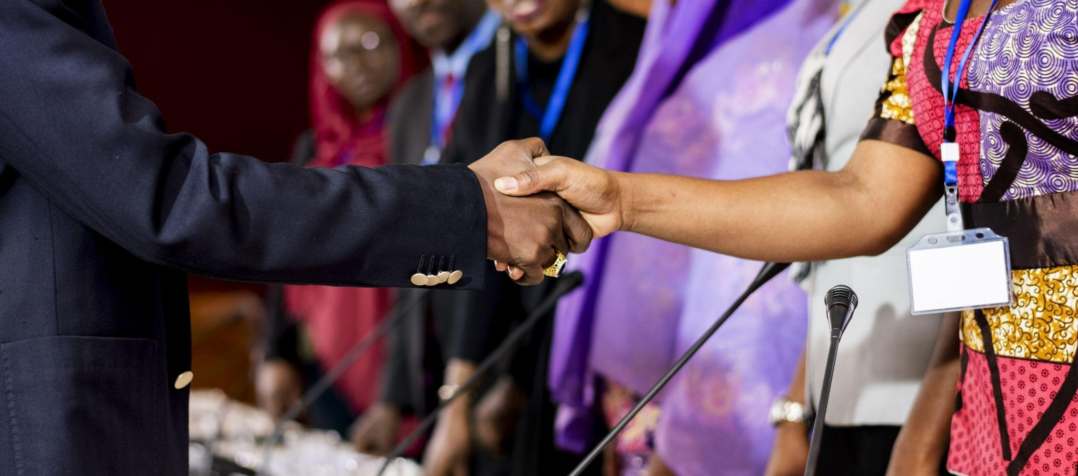
Objectives of the COP

Slide 3
Objectives of the COP
Open the works of the programme with its participants.
Learn more about the programme and provide contributions and recommendations to it.
Harvest expectations and address questions towards the initiative.
Establish initial bonds between fellows and start to create a sense of belonging to the cohort.
Open hearts and minds to the experiences that will be shared during the immersion in Brazil.

Slide 4
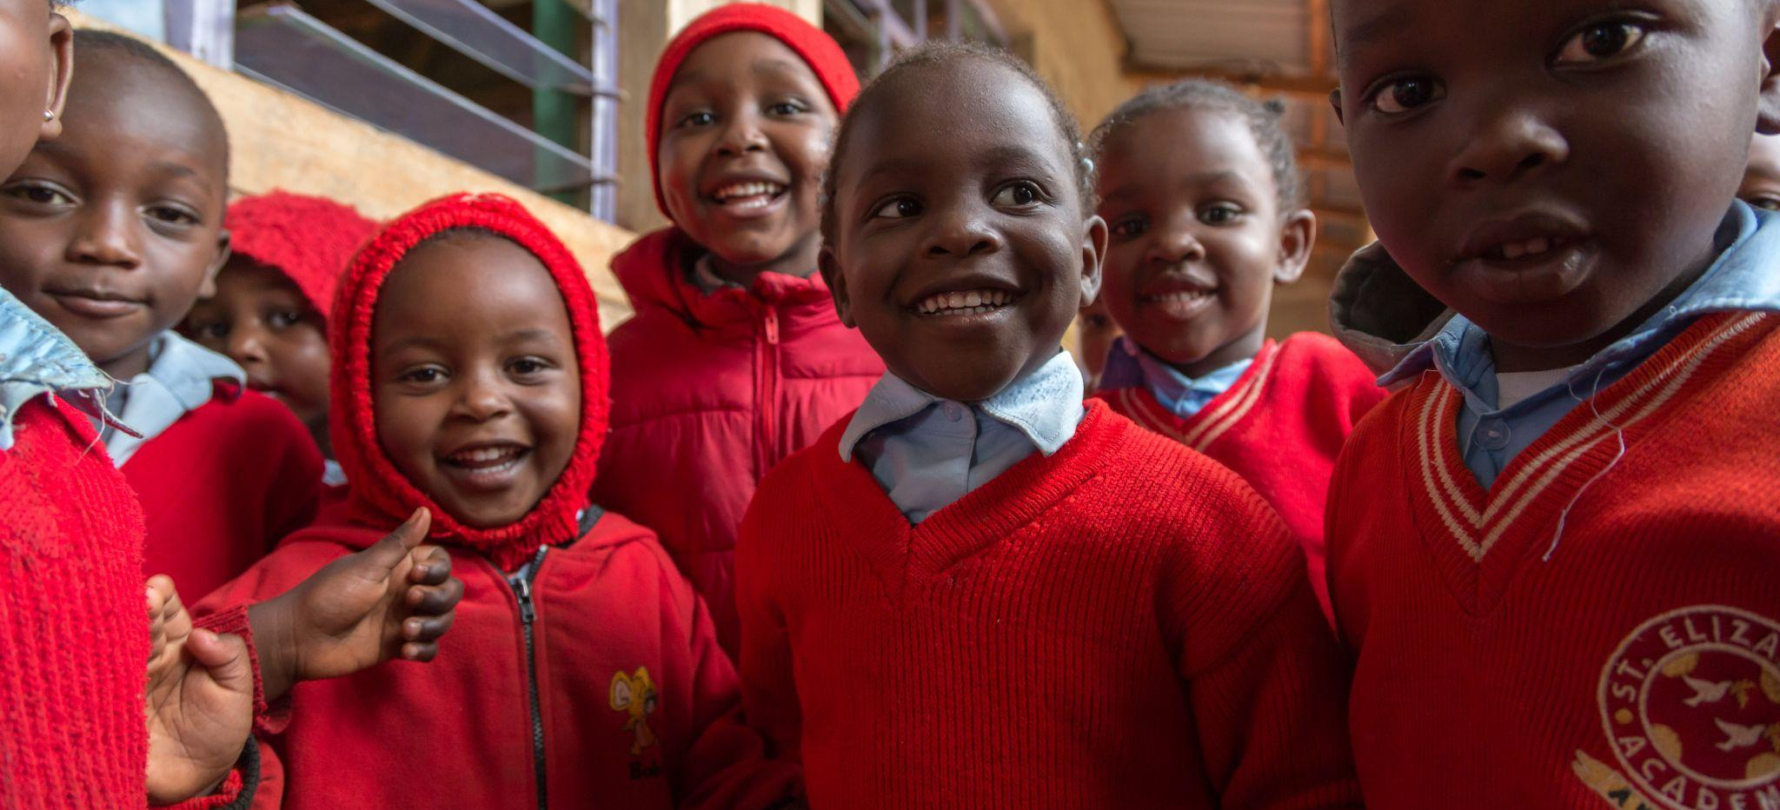
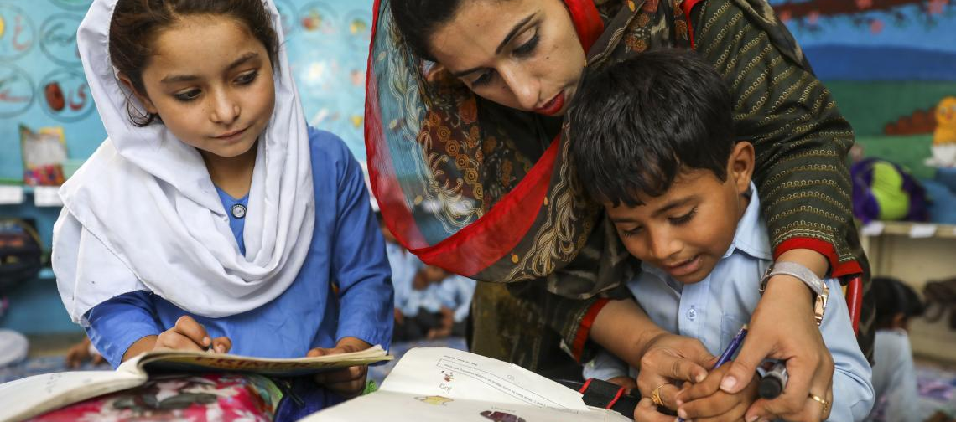
Who we are

Slide 5

Programme: who we are
24 fellows from Pakistan
28 fellows from Kenya
Notes:
Objectives are clear, relevant and feasible? Contents and methodological approach are aligned with objectives?

Slide 6
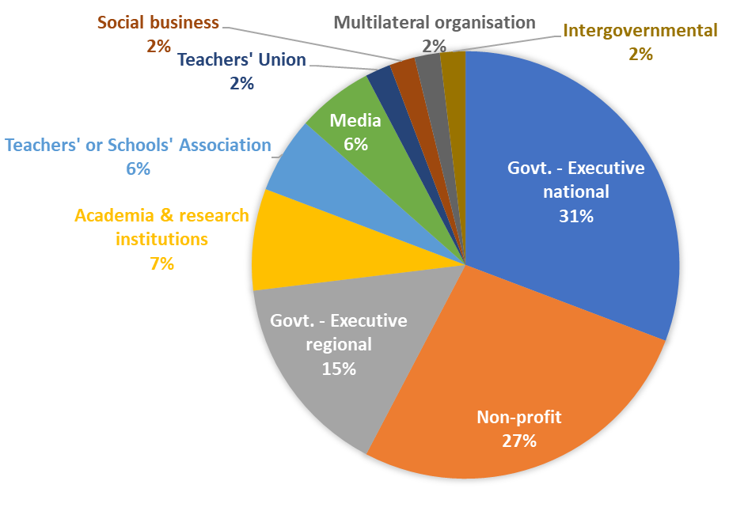
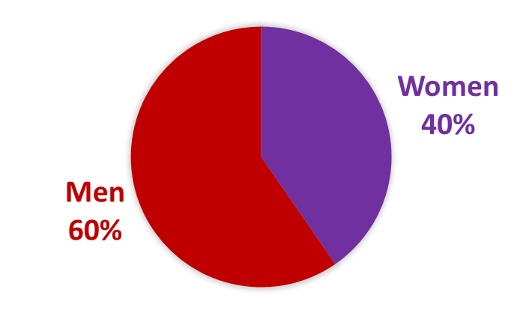
Fellows: who we are in figures
Sector | #
Govt. - Executive national | 16
Non-profit | 14
Govt. - Executive regional | 8
Academia & research institutions | 4
Teachers' or Schools' Association | 3
Media | 3
Teachers' Union | 1
Social business | 1
National office from multilateral org. | 1
Intergovernmental | 1
TOTAL | 52
Notes:
Objectives are clear, relevant and feasible? Contents and methodological approach are aligned with objectives?

Slide 7
Fellows: who we are
Kenya
Pakistan
Ministry of Education
National Treasury
Federal Board of Intermediate and Secondary Education
Ministry of Federal Education & Professional Training
Kenya Institute of Curriculum Development (KICD)
School Education Department, Govt. Punjab
Kenya National Examinations Council
Teachers Service Commission (TSC)
School Education Department, Govt. South Punjab
School Education and Literacy Department, Govt. Sindh
East African Community (EAC)
Govt. Balochistan
Kenya National Union of Teachers (Knut)
Secondary Education Department, Govt. Balochistan
Zizi Afrique
Elementary and Secondary Education Department, Govt. Khyber Pakhtunkhwa
Usawa Agenda
Kenya Private Schools Association (KPSA)
Idara-e-Taleem-o-Aagahi (ITA)
Kenya Primary Schools Headteachers Association (KEPSHA)
The Citizens Foundation
Lahore University of Management Sciences (LUMS)
Dignitas
Tabadlab
Filmmaking
Moi University
African Network for Internationalization of Education (ANIE)
Royal Media Services
Institute of Social and Policy Sciences (I-SAPS)
Balochistan Youth Action Committee
UNICEF
Notes:
Objectives are clear, relevant and feasible? Contents and methodological approach are aligned with objectives?

Slide 8
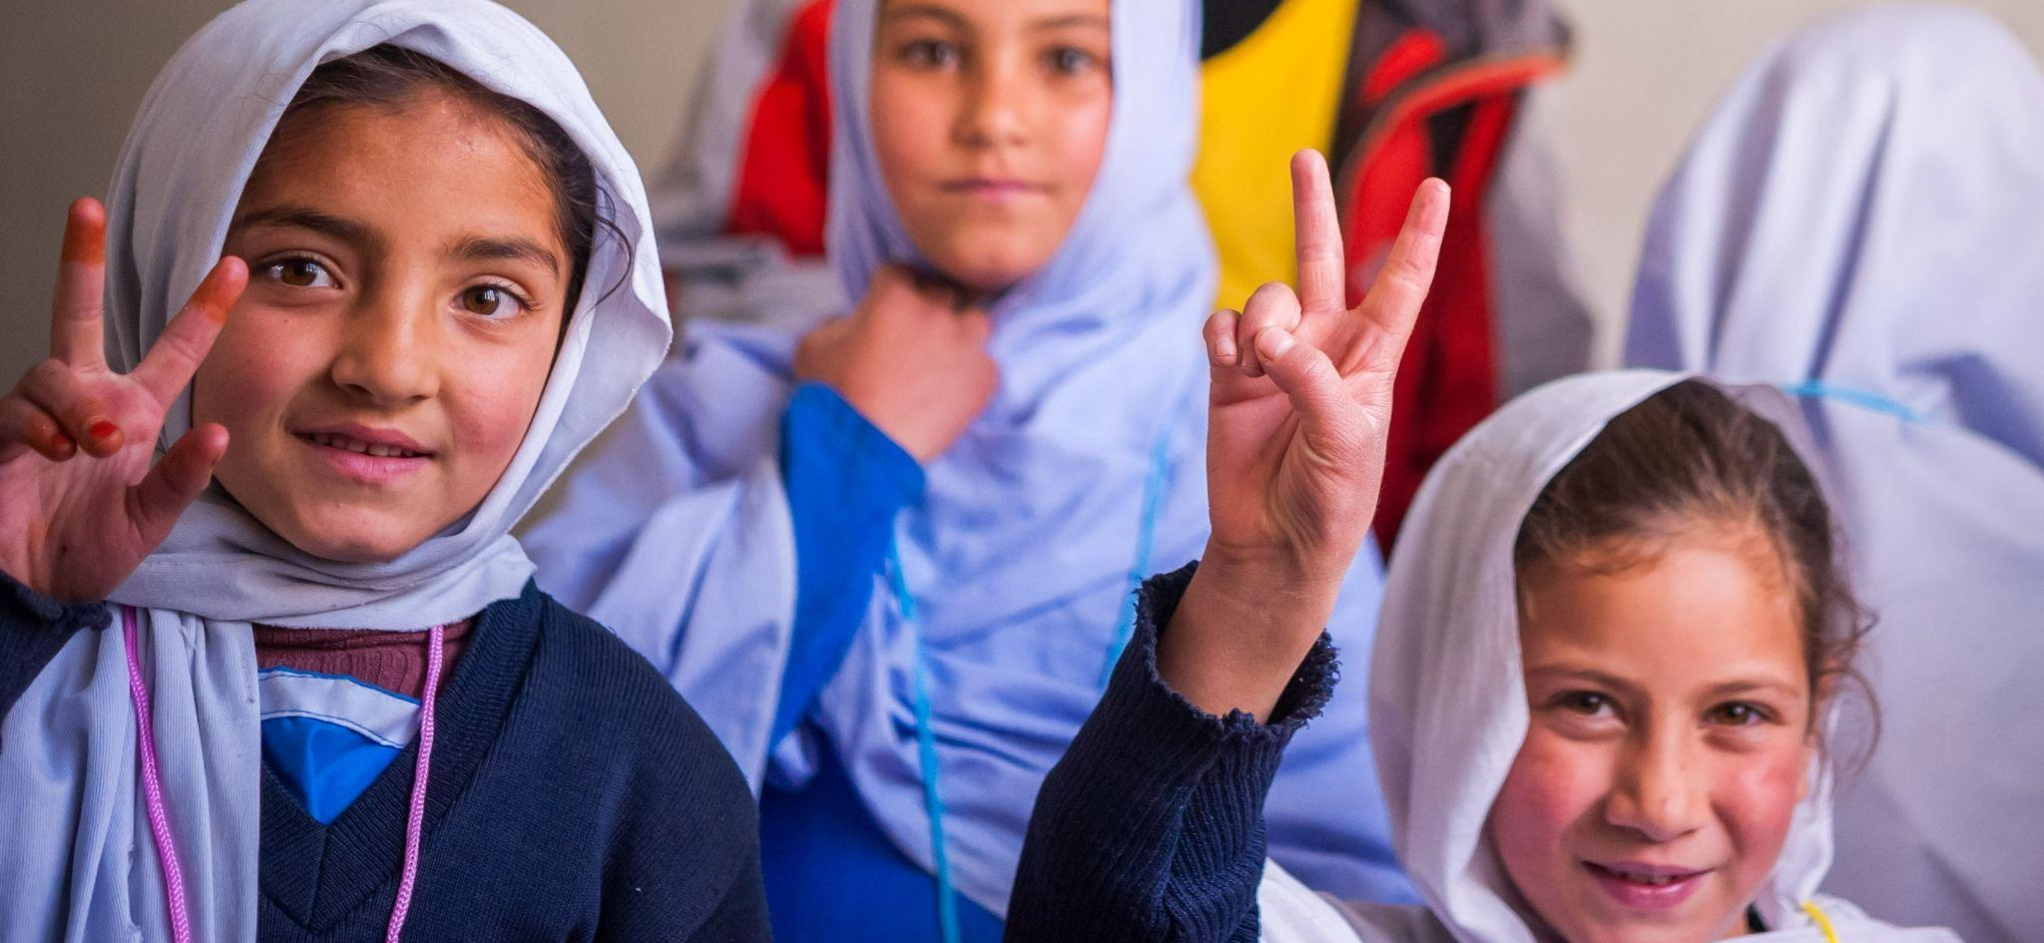
Expectations for the programme: survey results

Slide 9

Survey results
Leadership in education
Foundational learning
Education reforms
Cross-sectoral coalitions
TOPICS
Group discussions
Case studies
TYPES OF ACTIVITIES
Peer mentoring
Co-creation workshops
Lectures; self-reflective sessions
Notes:
Objectives are clear, relevant and feasible? Contents and methodological approach are aligned with objectives?

Slide 10
Survey results
In what ways could the South-South Programme and the current cohort most contribute to you and your work in the education field?
EDUCATION EXCHANGE
REFORMS
COALITIONS & IMPLEMENTATION
NETWORK
Connection with other leaders
Effective implementation of policies
Collaborate
Learning from other Global South countries
Learning about communication and advocacy
Lead a coalition for education reform
Learning from others
Community of support and practice
Policymaking across countries
Networking
Influencing government in policy making
Learning innovative strategies
Sharing own experiences
Visibility of our work
Design new programmes
Getting to know leaders from other Global South countries
Learning from successful reforms in Brazil
Learning from practices in countries with similar context
Learning about reforms that improve outcomes
Leaders can work together in solutions
Management of reforms
EVIDENCE & KNOWLEDGE
Benchmark
OUTCOMES
Evidence
LEADERSHIP
Improving education in Kenya
Co-create knowledge products and case studies
Content and steps to reforms that worked
Improving learning outcomes
Best practices
Learning from other people’s leadership style
Education leadership
Notes:
Objectives are clear, relevant and feasible? Contents and methodological approach are aligned with objectives?

Slide 11
Survey results
In what ways can you and your organisation most contribute to the Fellowship Programme and the current cohort?
LEARNING/ DOING WITH OTHERS
DESIGNING & IMPLEMENTING
SHARING
Share my leadership journey
Share success stories
Be a learning partner
Designing out of box ideas
Developing policies
Working with others in projects
Share materials
Share evidence of what worked/ did not work in Pakistan in the last decade
Put ideas into practice with partners
Brainstorm on challenges in the field
Developing action plans
Support discussions
Share knowledge
Manage and implement programmes
Share my/ our work
Leadership for change management
Share lessons
Share experiences
TOPICS OF EXPERTISE
Financing of education
ICT/ technology in education
School Leader and teacher professional development
Kenyan curriculum reform
Storytelling
Advocacy approach
Measuring social emotional competencies
No one left behind primary> secondary educ.
Accelerating learning of children furthest behind
Curriculum reform
Public sector of Pakistan
Instructional & leadership coaching
Notes:
Objectives are clear, relevant and feasible? Contents and methodological approach are aligned with objectives?

Slide 12

Immersion trip to Brazil

Slide 13
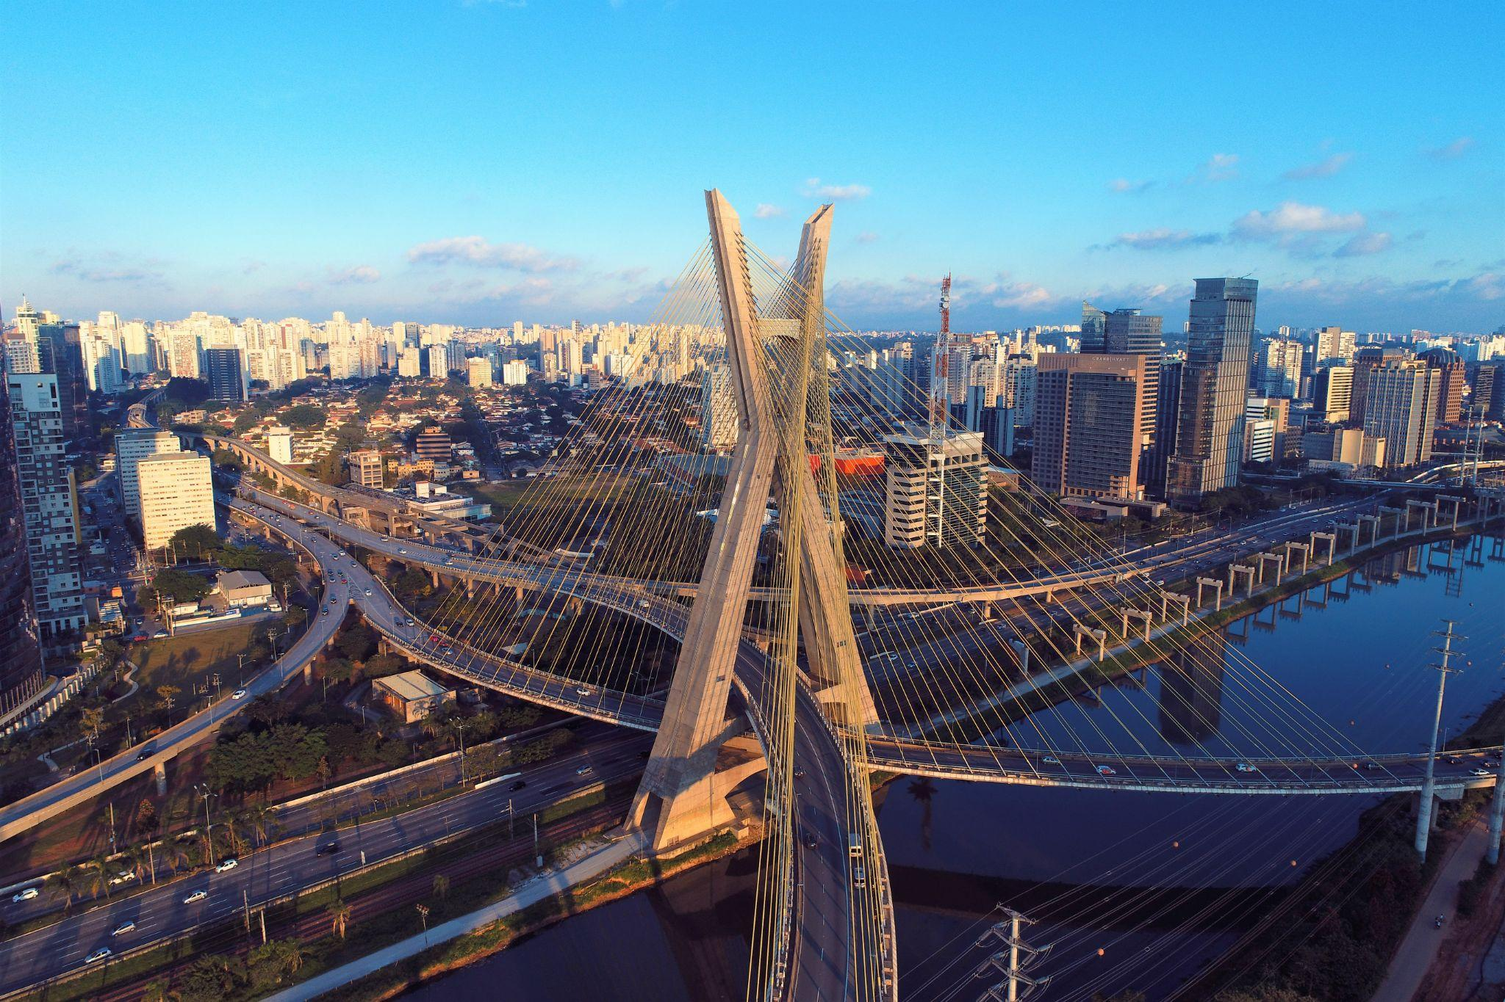
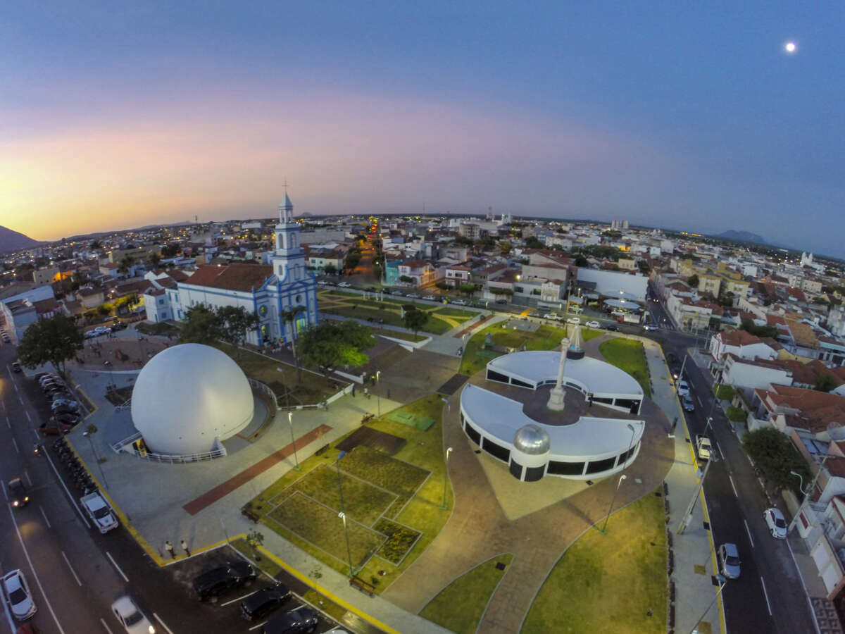
Immersion trip to Brazil
The activities proposed focus on:
Stimulating personal reflections and development;
Strengthening participants’ bonds and cohesion;
Expanding knowledge and exchanging experiences through the interaction with Brazilian cases and Brazilian organisations;
Fostering co-creation and allowing country groups to plan their next steps.

Slide 14
Day |  | Where | Activity
Sat | 10/Sep | São Paulo, SP | The group arrives from their home countries to São Paulo, Brazil
Sun | 11/Sep | São Paulo, SP | Optional leisure activities
Mon | 12/Sep | São Paulo, SP | Welcome, introductions, creation of safe and vibrant space Case: Movimento Pela BNCC Dinner with special guests
Tue | 13/Sep | São Paulo, SP | Case: Todos pela Educação/Educação Já Activity related to leadership, self-reflection, and strengthening of bonds Workshop to discuss priorities of educational reform in Kenya and Pakistan
Wed | 14/Sep | São Paulo> Sobral | Travel from São Paulo to Sobral Visit to rural area of Sobral: school and community
Thu | 15/Sep | Sobral, CE | Story of Sobral Visit to four schools (each fellow visits 2 schools) Meeting key political leaders (former and current mayors and governors) who started Sobral’s education revolution
Fri | 16/Sep | Sobral, CE | Meeting current technical leaders of the Secretariat of Education of Sobral Workshops to discuss coalition building/ advancement in Kenya and Pakistan
Sat | 17/Sep | Sobral> São Paulo | Travel from Sobral to São Paulo. Our flight lands in São Paulo at 14:35 if there are no delays. The group leaves from São Paulo to their home countries
Notes:
How to ensure the immersion will be an unique and transformative experience for each fellow and for the cohort?

Slide 15
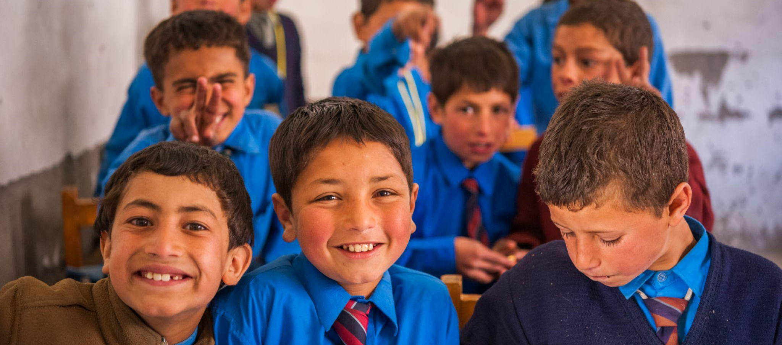
Scheduling next COPs

Slide 16
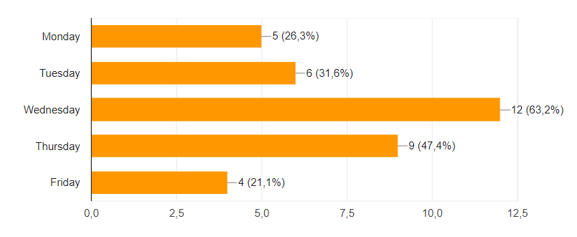
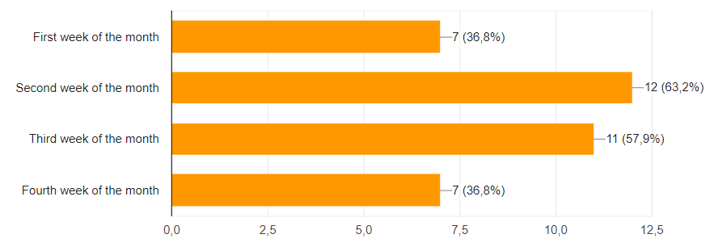
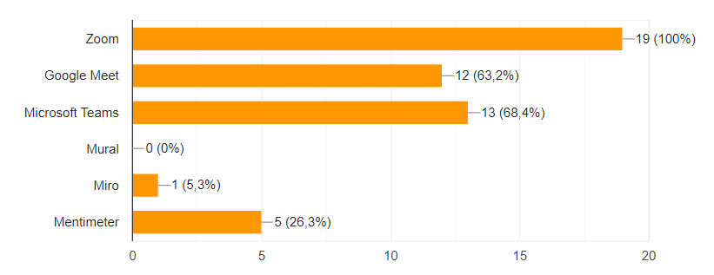
Scheduling next COPs: form results
Preliminary dates that will be confirmed soon:
25/Oct/2022
16/Nov/2022
11/Jan/2023
08/Feb/2023
08/Mar/2023
Notes:
Objectives are clear, relevant and feasible? Contents and methodological approach are aligned with objectives?

Slide 17
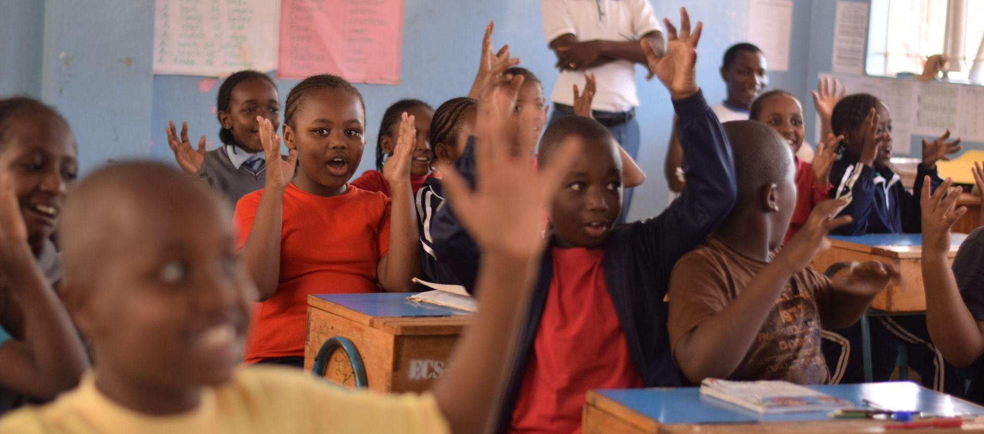
Collective agreements made

Slide 18
Collective agreements made
Presence
Democracy of time
Horizontality
Confidentiality
Assertiveness with kindness
Responsiveness
Diversity
Notes:
Objectives are clear, relevant and feasible? Contents and methodological approach are aligned with objectives?

Slide 19

COP#1: results of satisfaction form

Slide 20
COP#1: results of satisfaction form
Please find here the results of the satisfaction survey we shared at the end of the COP.
1 meant ‘Totally disagree’, and 5 meant ‘Totally agree’.
There were 29 answers.
 | The objectives of the session were met | The time was appropriate for the session | The content discussed during the session was useful | The session was interesting and engaging | The session was well planned and led | My questions have been solved | I felt comfortable in openly expressing my opinions during the session
Average score | 4.66 | 4.10 | 4.76 | 4.72 | 4.83 | 4.52 | 4.90
% of grades 4 or 5: | 96.6% | 79.3% | 100.0% | 96.6% | 100.0% | 96.6% | 79.3%
Notes:
Objectives are clear, relevant and feasible? Contents and methodological approach are aligned with objectives?

Slide 21
COP#1: results of satisfaction form
Comments | Suggestions
I enjoyed the easiness within the session. Most members seemed relaxed. … The session started off being very interactive and then faded off a bit. Just some soft feedback, very interesting session overall. Look forward to seeing everyone in October as I will not be travelling. All the best! The online moderation was super. The discussions were to the point. Bravo I loved the breakouts. Very exciting! Looking forward to COP & Fellowship! The session was well planned | Most frequent suggestion was to have a shorter call: 50% suggested 2h and 50% suggested 2h30 - Have the break out sessions a bit longer - Try highlight ICT in education reforms More time for interactions and experience sharing Consider the Primary Fellows to organize a 2-3 day learning with the Extended Group fellows (in-country) to have an ‘immersion’ at the end of the fellowship. We get some books with simple Brazilian words for social interaction Are the readings going to be attached ? […] Core Reading for everyone; Supplementary reading options would be good that can be done by those interested to expand their reading lists and background notes.. Many thanks it was super!

Slide 22
Thank you!

