Slide 1








Community of Practice #5
08/Feb/2023

Slide 2
SUGGESTIONS TO IMPROVE OUR ONLINE EXPERIENCE TOGETHER
Use a desktop or laptop instead of a mobile device.
Try to ensure at least a 10 mbps connection.
Have your camera turned on during the call.
Turn off all programs that send you notifications (e-mails, WhatsApp etc.).
Have video in full screen mode so as not to be distracted by other open tabs/ windows.
Be in a quiet space and have your audio muted throughout the call.
Have your Zoom in Gallery View.
Notes:
Objectives are clear, relevant and feasible? Contents and methodological approach are aligned with objectives?

Slide 3
OBJECTIVES OF THE SESSION
Improve the coalition plans that are being built by applying systems change concepts and by discussing how to reach national impact.
Get input from fellows to design the South-South transnational network.
Continue building trust and bonds among fellows.
Notes:
Objectives are clear, relevant and feasible? Contents and methodological approach are aligned with objectives?

Slide 4
COLLECTIVE AGREEMENTS
Presence
Horizontality
Punctuality
Democracy of time
Confidentiality
Assertiveness with kindness
Responsiveness
Diversity
Notes:
Objectives are clear, relevant and feasible? Contents and methodological approach are aligned with objectives?

Slide 5
Pre-work
Selected slides of the presentation:
Colleen Magner
Reos Partners, Africa office
Presentation on COP#4, 11/Jan/2023
Link for full presentation: here.
This material is not to be used or shared outside of the group of the fellows of the South-South Programme.
Notes:
Objectives are clear, relevant and feasible? Contents and methodological approach are aligned with objectives?

Slide 6
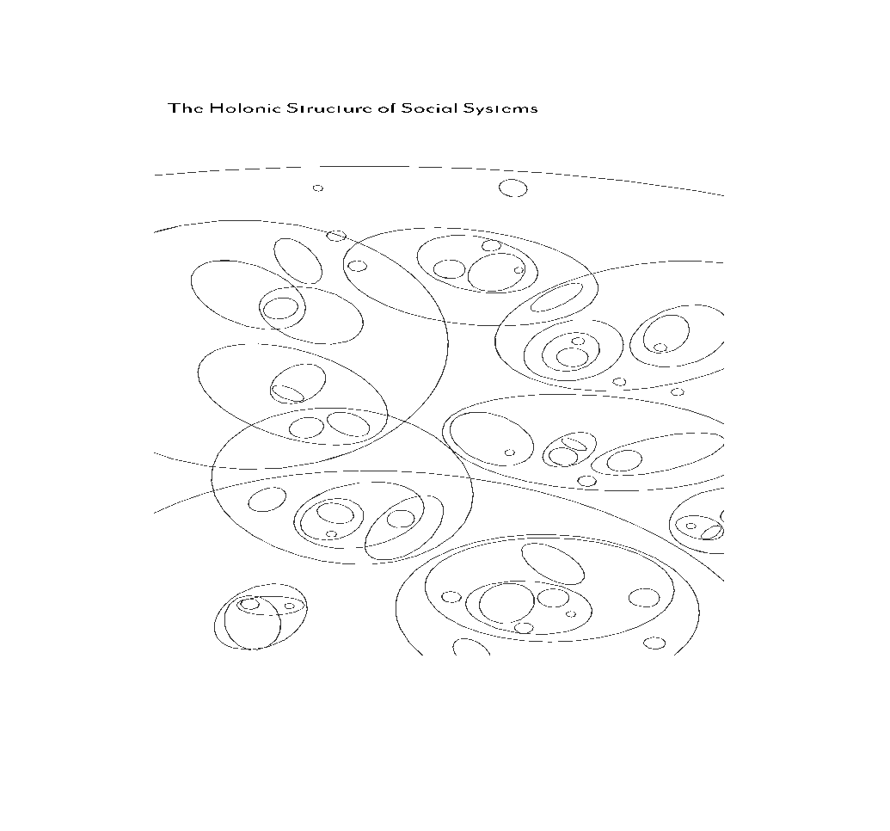
Holistic structure of systems

Slide 7
Five Levels of Change
These levels and their interactions, as well as how they inform the Reos Results Framework, are illustrated on the following pages.
To inform how we design our interventions to contribute to impact in the world, the Reos theory of change considers five levels:
1. Landscapes
The landscape is the level of the ultimate purpose of a systemic initiative: for example the actual carbon emissions, biodiversity levels, poverty trends, justice needs met, nutrition levels, violent conflict, etc. This is the space of human needs and planetary boundaries, the domain of shifting trends and bending curves. It is also the context in which an initiative takes place and which needs to be navigated.
2. Culture
Culture is the level of narratives, identities, values and paradigms. It shapes the lenses through which we observe and interpret the world. Our systems and structures are embedded in and reproduced by culture.
3. Structures
Systemic structures are the level of rules of the game – policies, institutions, processes, practices, power structures, resource flows, and infrastructures. They generate conditions that keep problematic situations in place and create constraints and opportunities for innovation.
4. Niche Innovations
Niche innovations provide new or adapted responses or ways to remove obstacles that hold a problematic situation in place. Niches are protected spaces where innovations can be incubated. The system provides the enabling environment or not for these innovations to scale. A critical mass of mutually reinforcing and effective innovations can be supported and scaled to influence systems and culture.
5. Agency and Capability
The inner transformation of agency (i.e. confidence, commitment) and the capacity (e.g., knowledge, awareness, skills, resources, power) of social innovators, changemakers, and system leaders enhances their ability to address problematic situations. This applies individually and collectively (e.g. at the level of teams, organizations, networks). The collective level involves the depth of trust, connection, shared understanding, and collaborative practice.

Slide 8
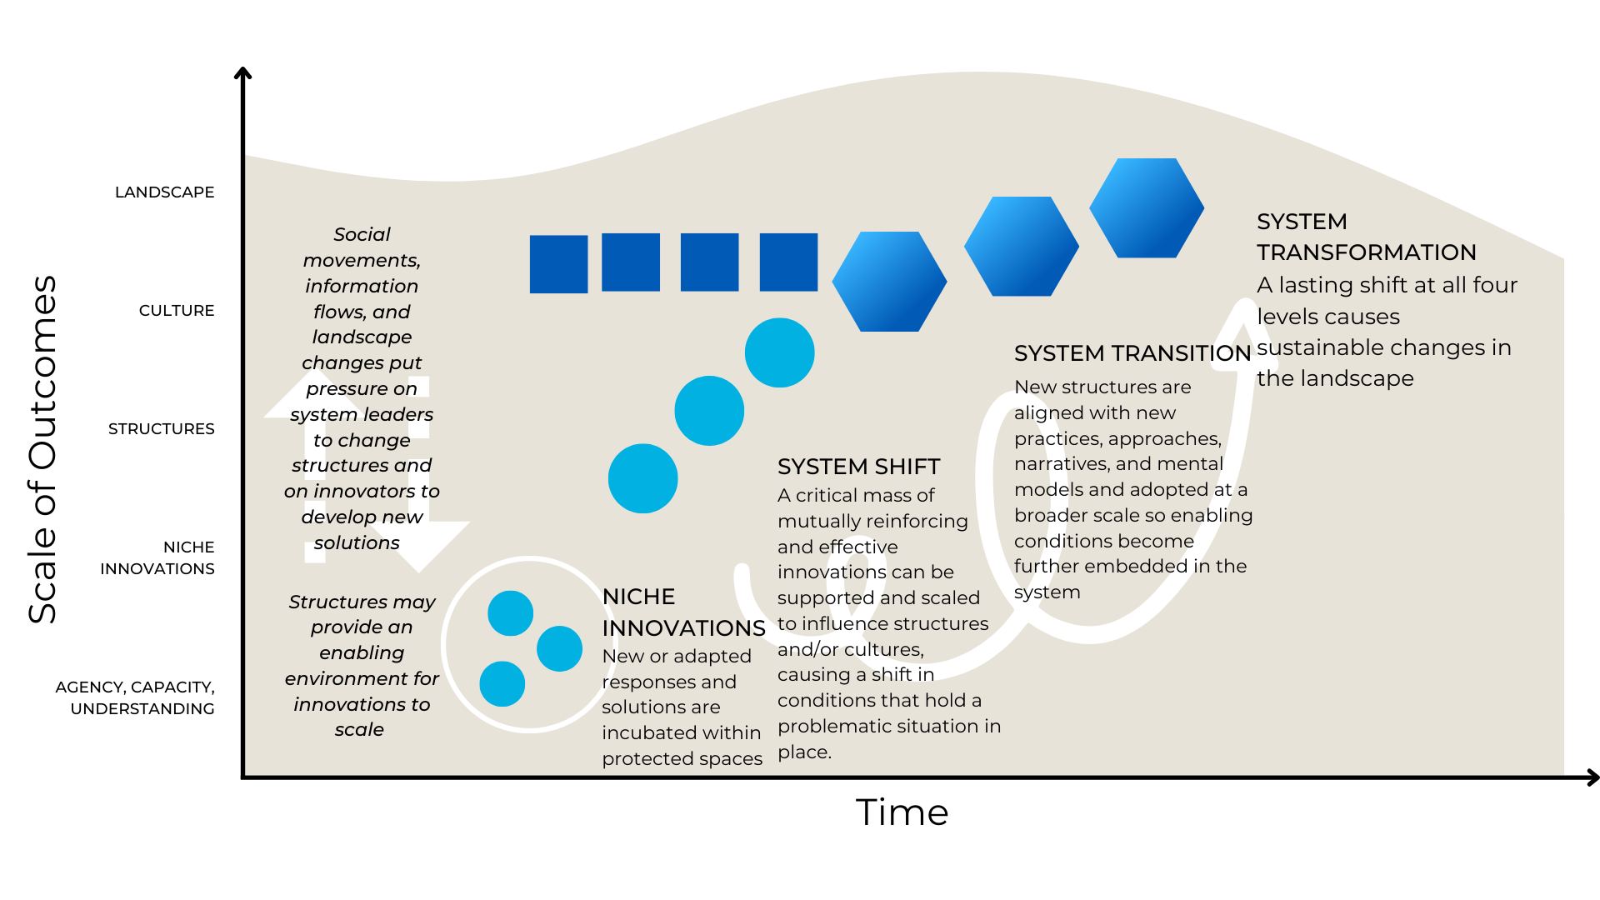
Reos Theory of Change
The Reos theory of change illustrates our understanding of how change happens in the world, within complex adaptive systems.
This diagram is not a depiction of a singular, linear narrative of change.
Rather it is intended to offer a language for strategic conversations about outcomes, contributions, synergies, and complementarities in systems change initiatives and to inform design of interventions.
It draws on work from the Reos Partners evaluation team with inspiration from Mark Cabaj of Here to There consulting and the work of Frank W. Geels.

Slide 9
Cumulative Impact
in Systems Change
Theory of Change
RESULTS THAT MAY BE ATTRIBUTABLE TO AN INITIATIVE
RESULTS AN INITIATIVE CONTRIBUTES TO
Agency, Capacity & Understanding
Niche Innovations
System Shift
System Transition
System Transformation
A portfolio of new or adapted responses that stakeholders develop or adapt and implement to address a problematic situation
Promising changes are institutionalized in the system, catalyzing a shift in the structural and/or cultural conditions (systemic drivers) that hold the problematic situation in place.
New practices, approaches, and structures, are adopted at a broader scale and rooted in shared narratives, values, mental models. Enabling conditions become further embedded in the system through alignment and mutual reinforcement between structure and culture.
Increase in the agency, capacity, relationships, commitments, and understanding of innovators and other stakeholders to be able to address a problematic situation
A lasting shift at all four levels (capacity, innovation, structure, and culture) contributes to changes in the landscape. This is mission-level impact.
The cumulative impact scale illustrates increasing extent of ambition and impact. This is not a linear process.

Slide 10
Pre-work
Selected slides of the presentation:
Veveu Arruda
Associação Bem Comum, Brazil
Presentation on COP#4, 11/Jan/2023
Link for full presentation: here.
Notes:
Objectives are clear, relevant and feasible? Contents and methodological approach are aligned with objectives?

Slide 11

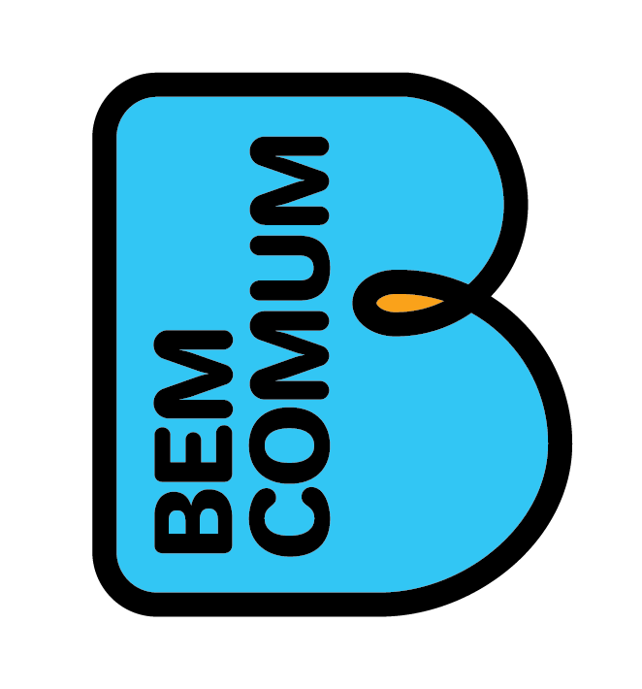
Systemic EpV intervention model
Political pact
Sharing experiences and learning
Initial diagnosis
Communication strategies
Action plan
4 Year Cycle
Legal instruments for sustainability
Internal reorganization of the department
Valuing education professionals
Diagnostic, formative and summative assessments
School monitoring
Courses for teachers, trainers and school managers
Pedagogical didactic materials

Slide 12
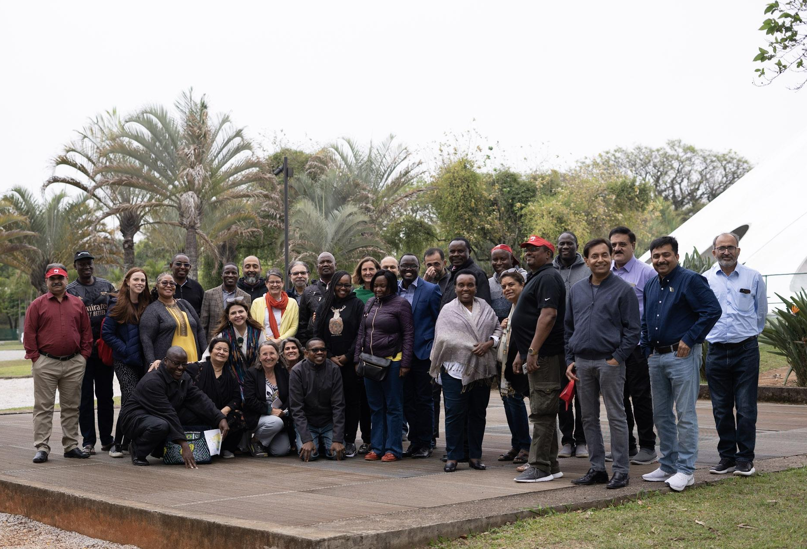
Transnational network of the South-South Programme

Slide 13
PROGRAMME’S FRONTS
FELLOWSHIP PROGRAMME
GLOBAL PUBLIC GOODS
TRANSNATIONAL NETWORK
Executive course for senior education leaders (fellows);
Goal is to expand leaders’ capacity to build coalitions to reform their countries' education systems;
Virtual and in-person meetings, including an immersion trip to Brazil;
8-month long (Aug/22-Mar/23).
‘Global public goods’ are learning resources that equip education leaders with the knowledge, evidence, and tools on how to effectively lead coalitions and reform education systems;
They will be freely available for a global audience;
The Library of Global Public Goods will be launched in Mar/23 at the Blavatnik School of Government - Oxford.
Goal is to promote education exchange among Global South education leaders;
The network will keep all involved in the programme connected after the programme ends (Mar/23) and will absorb fellows from future cohorts as well;
Network will also mobilise the use of global public goods by fellows and other Global South leaders.
CROSS-SECTORAL COALITIONS
EDUCATION REFORMS
FOUNDATIONAL LEARNING

Slide 14
TRANSNATIONAL NETWORK
Goal is to promote education exchange among Global South education leaders;
The network will keep all involved in the programme connected after the programme ends (Mar/23) and will absorb fellows from future cohorts as well;
Network will also mobilise the use of global public goods by fellows and other Global South leaders.
We intend to establish a partnership with an existing transnational network
  This way, we build on and contribute to efforts already in place
Suggestions of networks:
  PAL Network
  RELI

Slide 15
ADVANTAGES OF EACH NETWORK PRESENTED
PAL NETWORK | RELI
Mission: PAL is a south-south partnership working across Africa, Asia and America to promote children’s foundation learning. Zizi Afrique, ASER Pakistan (ITA), and Usawa Agenda are already members; John Mugo and Baela Jamil are already part of the Board of Directors; 17 member organisations; PAL Network joined our immersion trip (Nico Buchbinder) and is relatively close to the programme already. | Mission: RELI is a member-driven initiative working to ensure inclusive learning for all children in East Africa. Zizi Afrique, Dignitas, and Usawa Agenda are already members; 70+ member organisations; Aims to expand its reach to the Global South; Aims to focus on strengthening leaders that promote social justice; Showed interest in potentially hosting the South-South network.

Slide 16
A world where all children have a foundation for lifelong learning

Slide 17

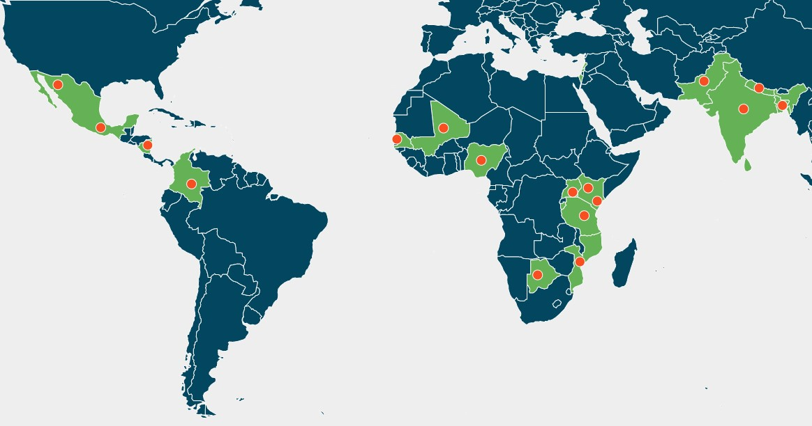
Our Growth
17
1M+
60+
03
volunteers
17
40+
years
assessments
continents
members
languages
15
9M+
155k+
countries
Children
Assessed
Children Equipped with Foundational Literacy and Numeracy (FLN)

Slide 18
Our commitments for the next 3 years
EVIDENCE FOR LEARNING | MY VILLAGE, A LEARNING VILLAGE | A VIBRANT COMMUNITY OF PRACTICE
Using Citizen-led Assessments and our recent Common Assessment tools (ICAN & ELANA) conduct a nationally representative large-scale assessment of foundational literacy and numeracy in 15 countries across the global south. Inform parents, national governments, regional and global organizations about the state of learning in the global south mapped to SDG 4. | Ensure that ALL children in 1 million villages in the global south can read and do basic math (currently, we are piloting this in 300 villages of 3 countries). Support the education systems to adopt innovative approaches to improve reading and basic math. Improve parental engagement and local accountability systems to prioritize foundational learning. | Promote global south led knowledge sharing platforms to support FLN. Increase global south voices in international debates about education

Slide 19
RELI Africa?
Regional peer learning initiative and policy influencing network.
Scope: Kenya, Uganda & Tanzania
Our vision is An East Africa region where all children receive a quality education regardless of race, colour, creed or ability.
Notes:
A voice from the Global South on Matters education.
A network by the people for the people
Membership
Diversity of experience- Implementers, experts
Membership is open and expanding. Criteria targeting those that are working to improve the learning agenda

Slide 20


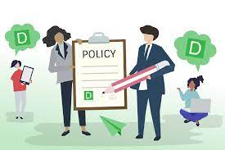
RELI Africa work and activities are based on three pillars
Transforming Organisations
Notes:
Transforming organisations by supporting and strengthening organizations and leaders to design, evaluate, refine, and scale promising models to transform them into high functioning vehicles of regional change for education. This is achieved through cultivating self-learning and peer-to-peer learning from shared experiences and building the capacity of member organisations and encouraging proactive collaboration for better impact.
Building a knowledge hub through generation of evidence of what is working and what is not working and monitoring new developments in the field of education to bridge a persistent lack of evidence on what works and what doesn’t work. The RELI Africa knowledge hub synthesizes information to inform its interventions and for policy influencing and RELI members have been able to inform education discourses at the local, national, regional, and international levels.
Collaborative Policy Engagement by drawing on members’ collective experience to generate evidence to influence inclusive education policies and their implementation at the local, national, regional, and global levels.

Slide 21

The activities in RELI are implemented along three thematic areas (Country Level)
Learner Centred Teaching (LCT)
Equity and Inclusion
Values and Life Skills (VaLi)
Notes:
1. Learner Centred Teaching (LCT): This group explores strategies for enhancing the learning experience. This includes ideating ways of improving the instruction methods used by teachers to reach learners of different abilities while making learning interesting. LCT also collaborates with different stakeholders for a holistic learning approach.
2. Equity and Inclusion: This thematic group looks at opportunities for enhancing equity and inclusion for all learners without discrimination.
3. Values and Life skills VaLi: This group focuses on generating and sharing evidence and strengthening practices that support the acquisition of values and life skills in Kenya. It also looks at the role of values and life skills in the lives of learners for holistic development of the person. This involves coming up with ways of understanding, nurturing and assessing life skills acquisition and how they are being applied in the lives of the child. It works to support initiatives that support the integration of values and life skills in the education system and curriculum.

Slide 22
RELI Africa Niche’ in tackling Education Justice
Collaboration is becoming more strategic in scaling long lasting and transformative models that enhance improved learning and training outcomes.
RELI Africa has created a strong collaborative foundation amongst its members that has enabled it to develop a relationship with Education ministries in Kenya, Uganda and Tanzania which is strategic for policy influencing.
Evidence generation, learning and knowledge synthesis practices across member organizations enable RELI to provide evidence-based thought leadership on Education.
Notes:
Inter-organizational collaboration has become a primary global strategy for addressing social, economic, political and other forms of developmental concerns. As the complexity of these problems increases, that even a large actor cannot solve alone, the need for collaboration becomes more urgent and building partnership models which are long lasting, scalable and transformative, and which create shared value is therefore key.
RELI Africa is a growing best practice example on Sustainable networking for strengthened collaborative impact for education. RELI strives to build a strong community of actors for the improvement of learning and training for all. Our journey has been transformative and continues to be so. Our intention is to continue cultivating existing expertise and passion to accelerate the improvement of learning and training outcomes, especially for children and youth furthest behind TOGETHER.

Slide 23
QUESTIONS
What is the best transnational network for us to establish a partnership?
What are the specific objectives of keeping connected that would be most helpful to you after the programme ends?
Which type of activities and materials would you like this network to develop?
Notes:
Objectives are clear, relevant and feasible? Contents and methodological approach are aligned with objectives?

Slide 24
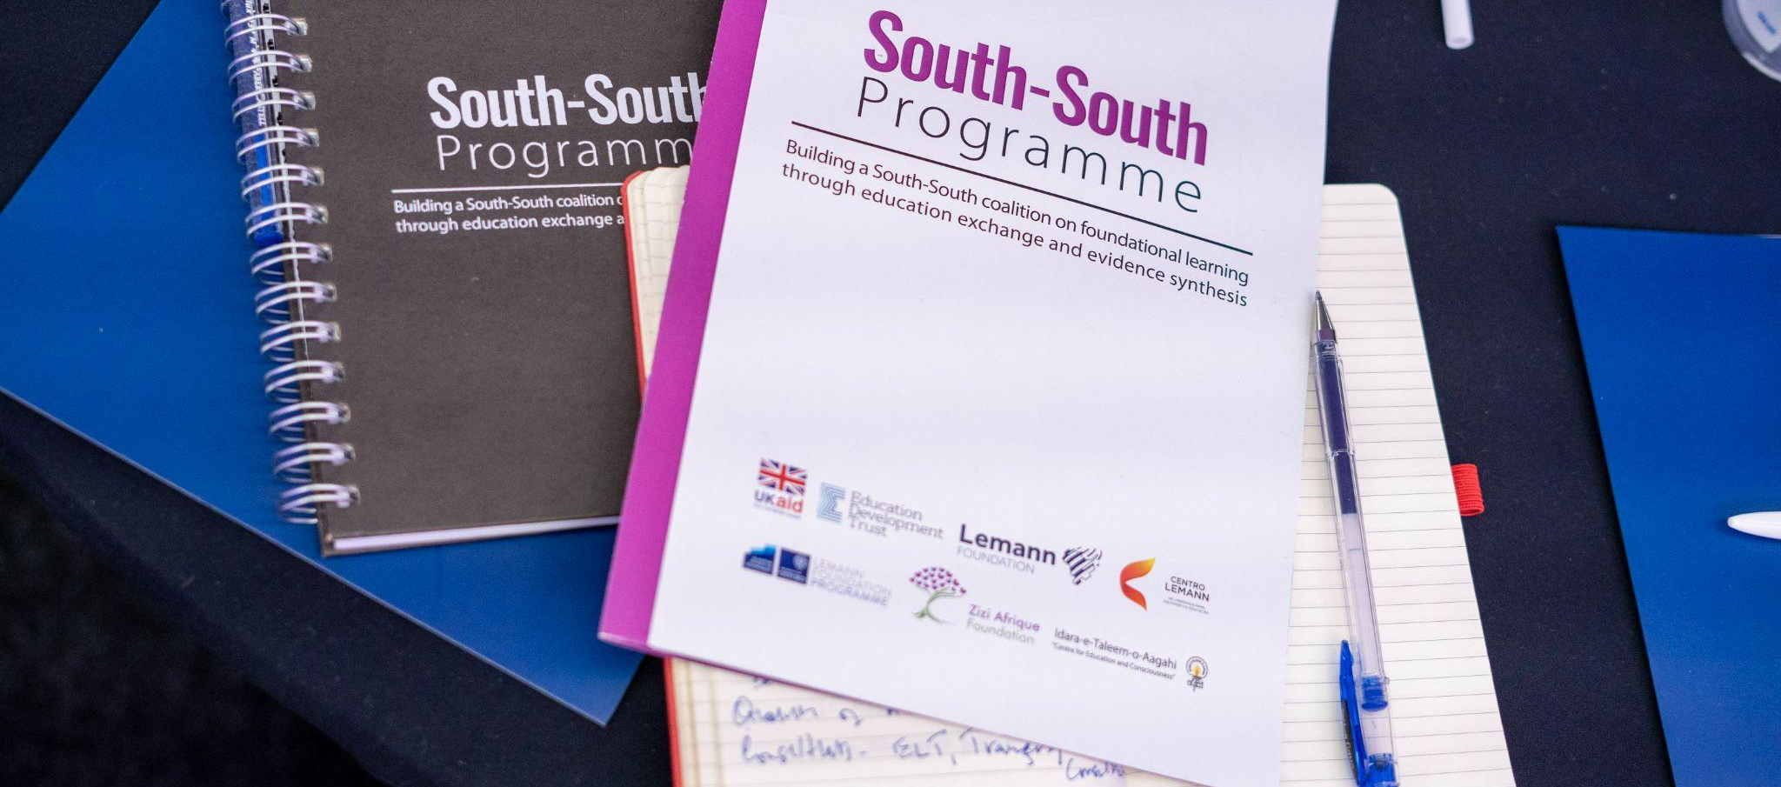
COP#5: results of satisfaction form

Slide 25
COP#5: results of satisfaction form
Please find here the results of the satisfaction survey we shared at the end of the COP.
1 meant ‘Totally disagree’, and 5 meant ‘Totally agree’.
There were 20 answers.
 | The objectives of the session were met | The time was appropriate for the session | The content discussed during the session was useful | The session was interesting and engaging | The session was well planned and led | My questions have been solved | I felt comfortable in openly expressing my opinions during the session
Average score | 4.5 | 4.3 | 4.7 | 4.8 | 4.7 | 4.5 | 4.8
% of grades 4 or 5: | 95% | 85% | 100.0% | 100% | 100% | 90% | 100%
Notes:
Objectives are clear, relevant and feasible? Contents and methodological approach are aligned with objectives?

Slide 26
COP#5: results of satisfaction form
Comments | Suggestions
Thanks for enlightened discussions Sad the executive programme is coming to an end. It has been a wonderful experience. Always exciting to be in the program Good planning and facilitation - I learnt a lot Kudos. The breakouts were also great! It seems the time has flown by and we became a great family | 150 minutes at the end of the working day in Pakistan is too taxing a session. Please try to make it shorter. In any case it shall be no longer than 2 hours. session should be more engaging Share feedback on the google document on objectives and the anchor network.

Slide 27
Thank you!

