Slide 1








COP#6
13/Mar/2023

Slide 2
OBJECTIVES OF THE SESSION
To remember the key moments of our learning journey, having key lessons reinforced
To reflect and discuss the continuity of the work of the South-South Programme in its new phase
To consolidate the bonds that are the foundation for the continuity of the joint work in the new phase
To celebrate the achievements of each participant, each country — Kenya and Pakistan —, and all the Community of Practice.
Notes:
Objectives are clear, relevant and feasible? Contents and methodological approach are aligned with objectives?

Slide 3
COLLECTIVE AGREEMENTS
Presence
Horizontality
Punctuality
Democracy of time
Confidentiality
Assertiveness with kindness
Responsiveness
Diversity
Notes:
Objectives are clear, relevant and feasible? Contents and methodological approach are aligned with objectives?

Slide 4

Looking ahead

Slide 5
LOOKING AHEAD
The Fellowship Programme is coming to an end, but the
South-South work continues
COALITIONS IN PAKISTAN AND KENYA
TRANSNATIONAL NETWORK
GLOBAL PUBLIC GOODS
Notes:
Objectives are clear, relevant and feasible? Contents and methodological approach are aligned with objectives?

Slide 6
LOOKING AHEAD
The Fellowship Programme is coming to an end, but the
South-South work continues
COALITIONS IN PAKISTAN AND KENYA
TRANSNATIONAL NETWORK
GLOBAL PUBLIC GOODS
Notes:
Objectives are clear, relevant and feasible? Contents and methodological approach are aligned with objectives?

Slide 7
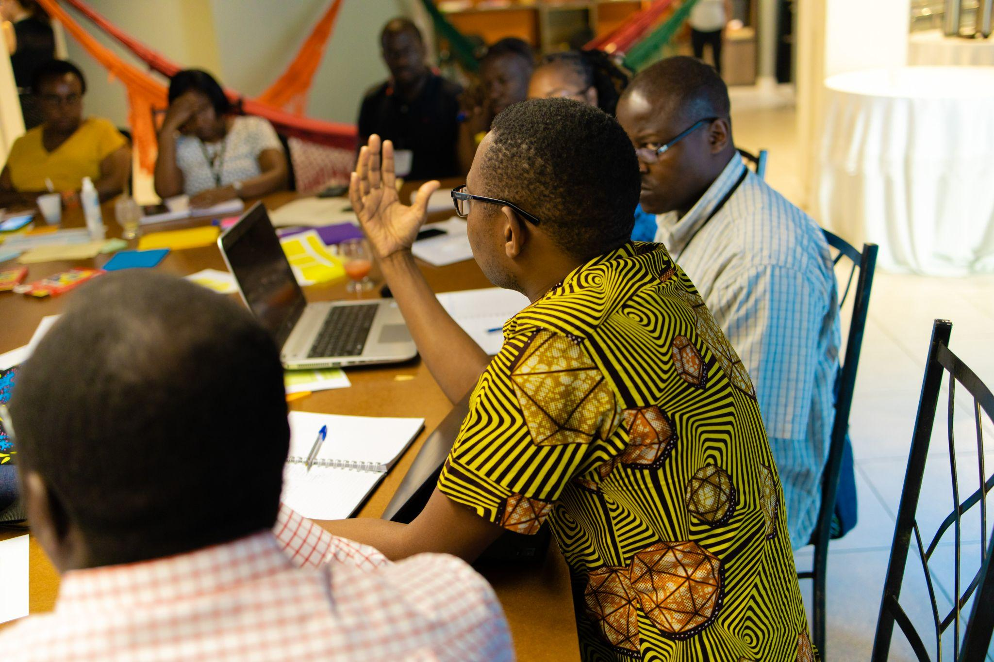
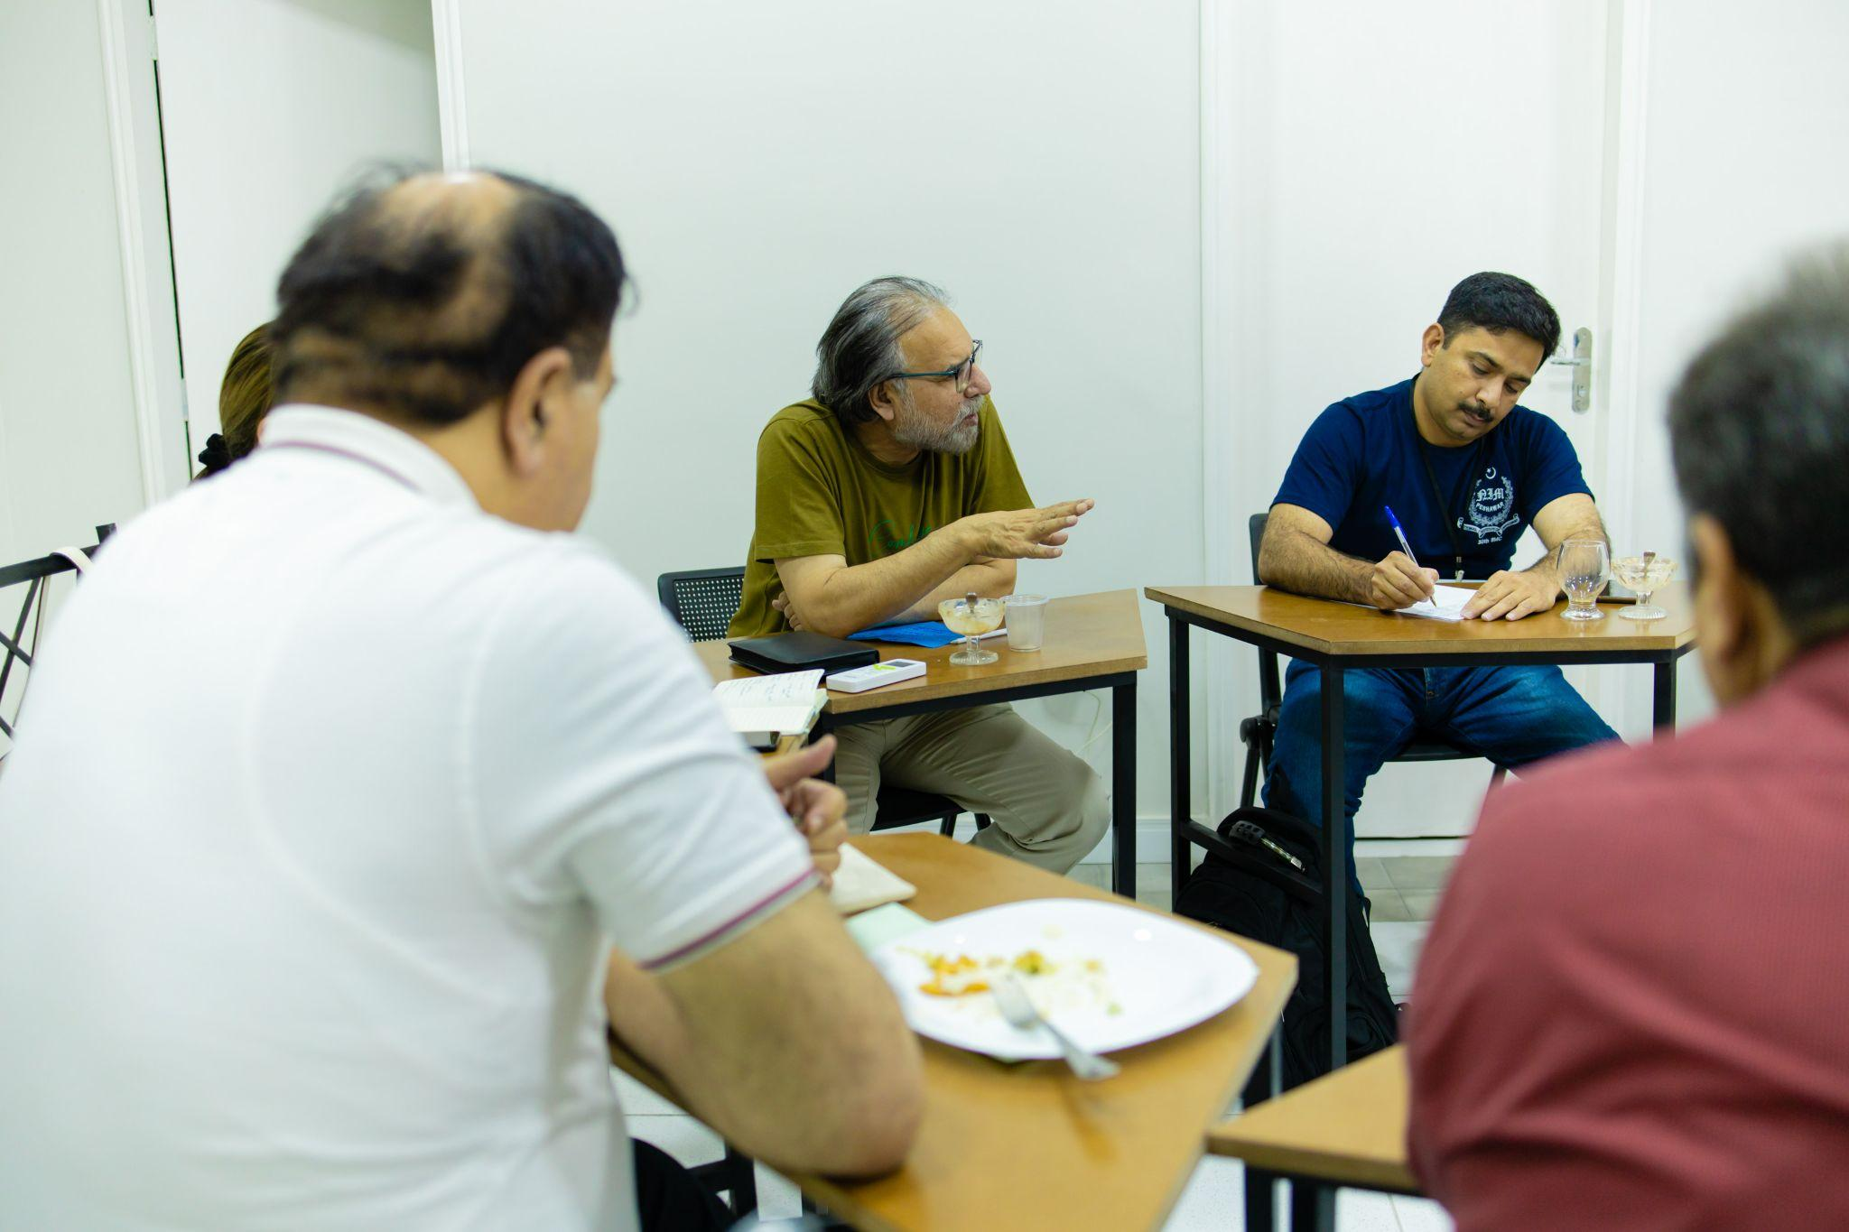
LOOKING AHEAD
How we can keep the coalitions we created alive and vibrant in the long-run
Recap of the premises for building coalitions for education reforms we discussed in the immersion trip
Alice Ribeiro (Movement for the National Learning Standards) will give her expert advice on how to keep a coalition vibrant and going
We will then collect & share with the group your view on where we are in the coalition / what we should prioritise in the new, coming phase
Notes:
Objectives are clear, relevant and feasible? Contents and methodological approach are aligned with objectives?

Slide 8
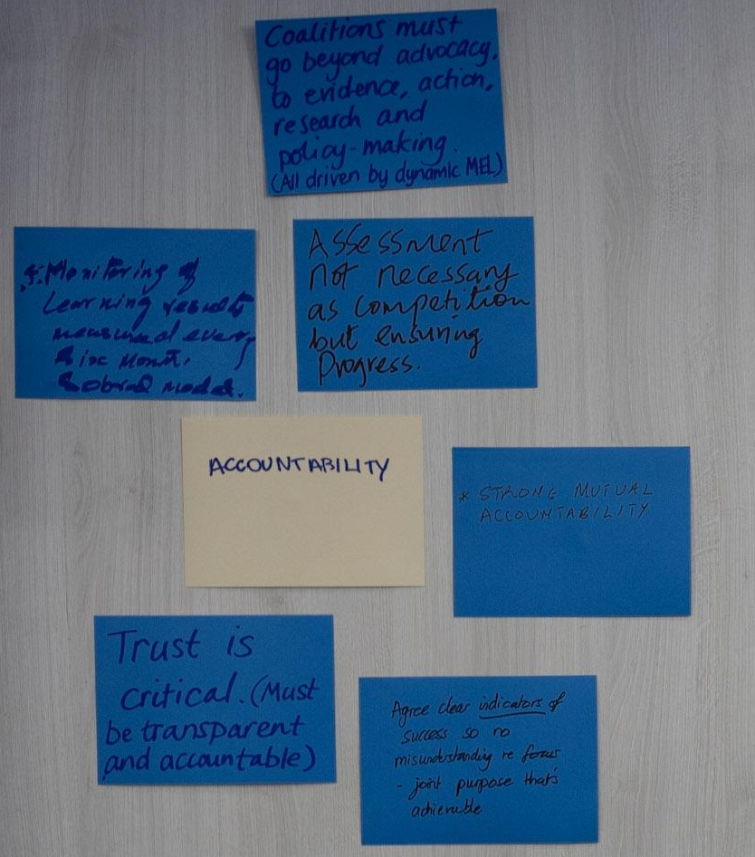
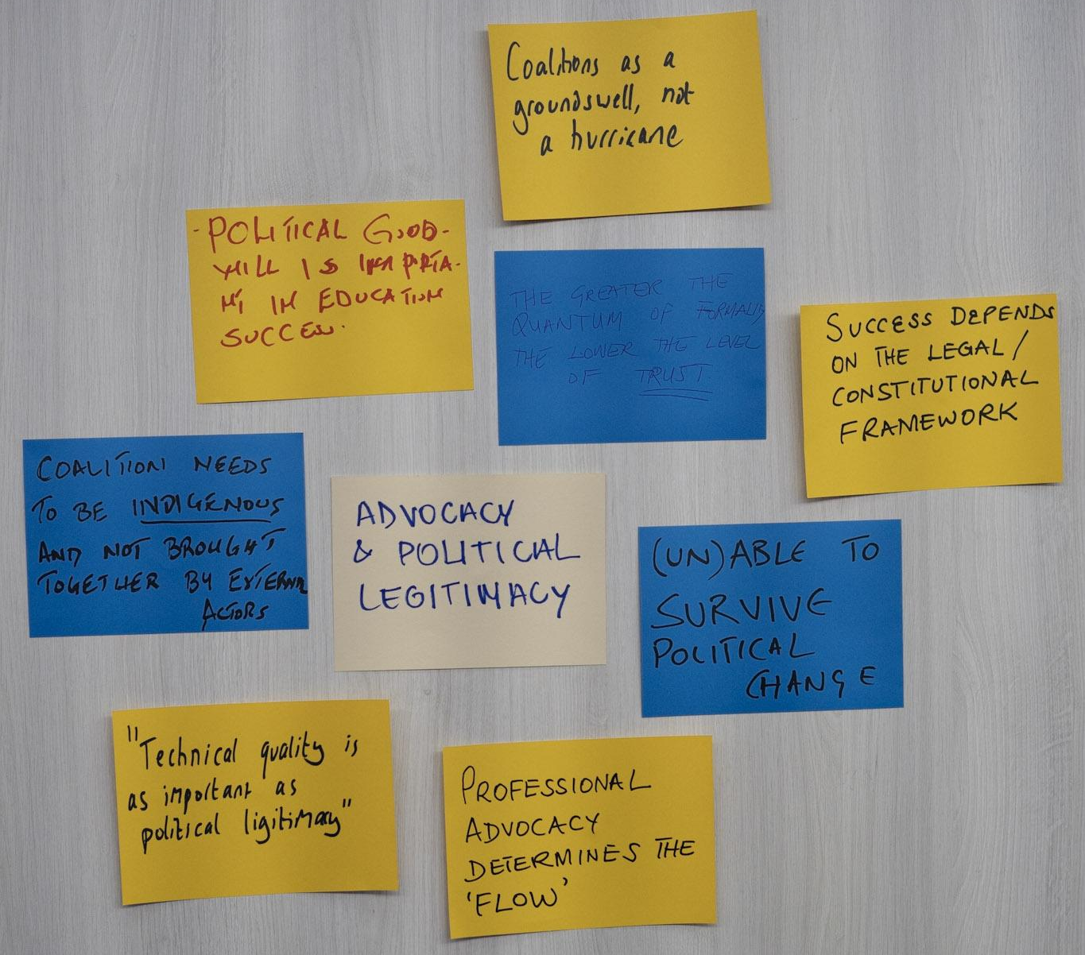
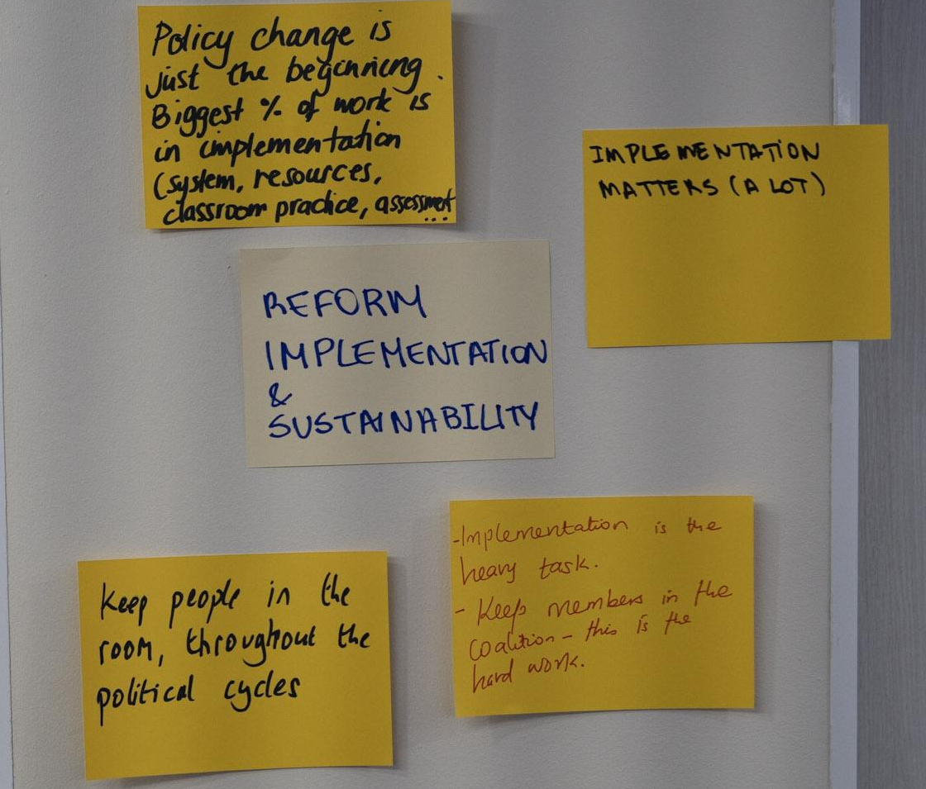
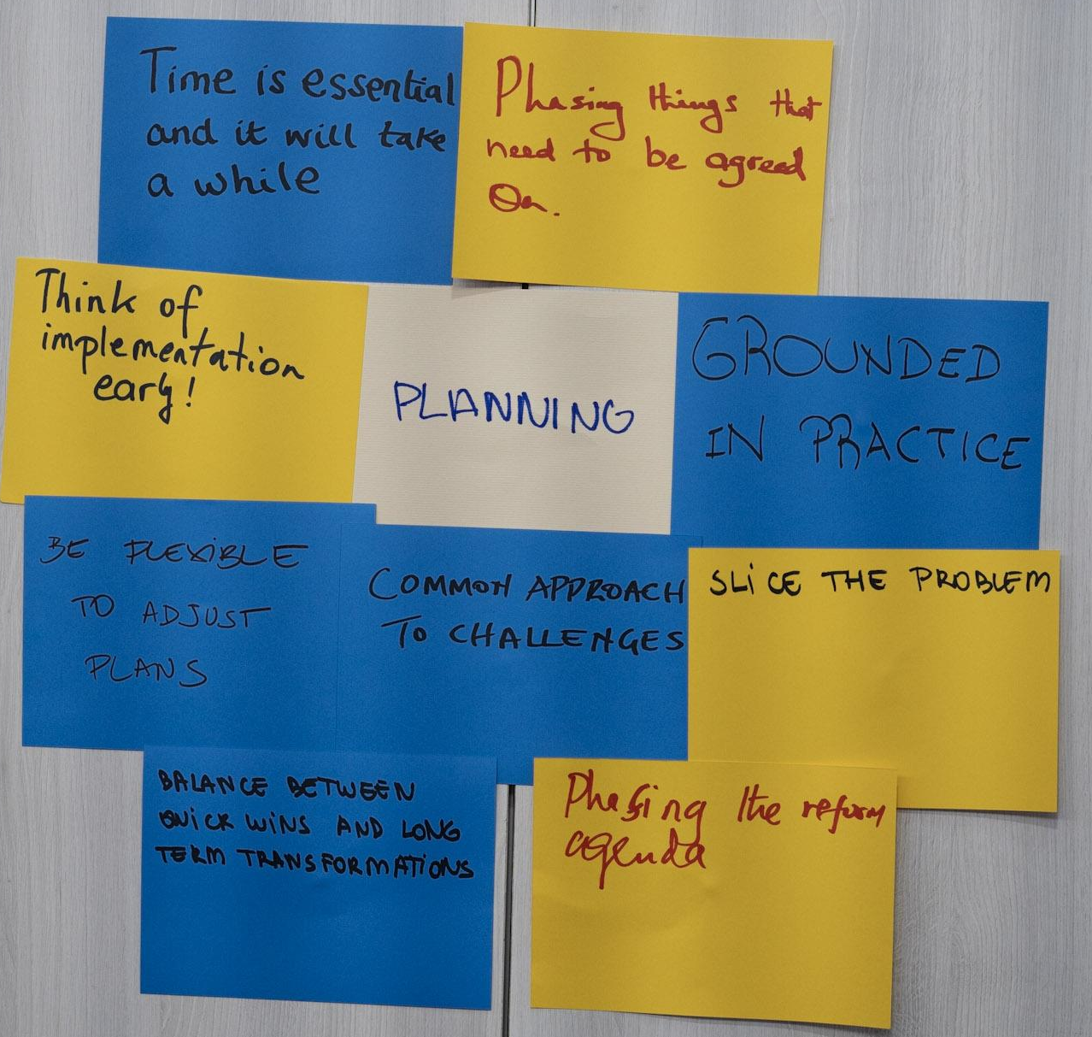
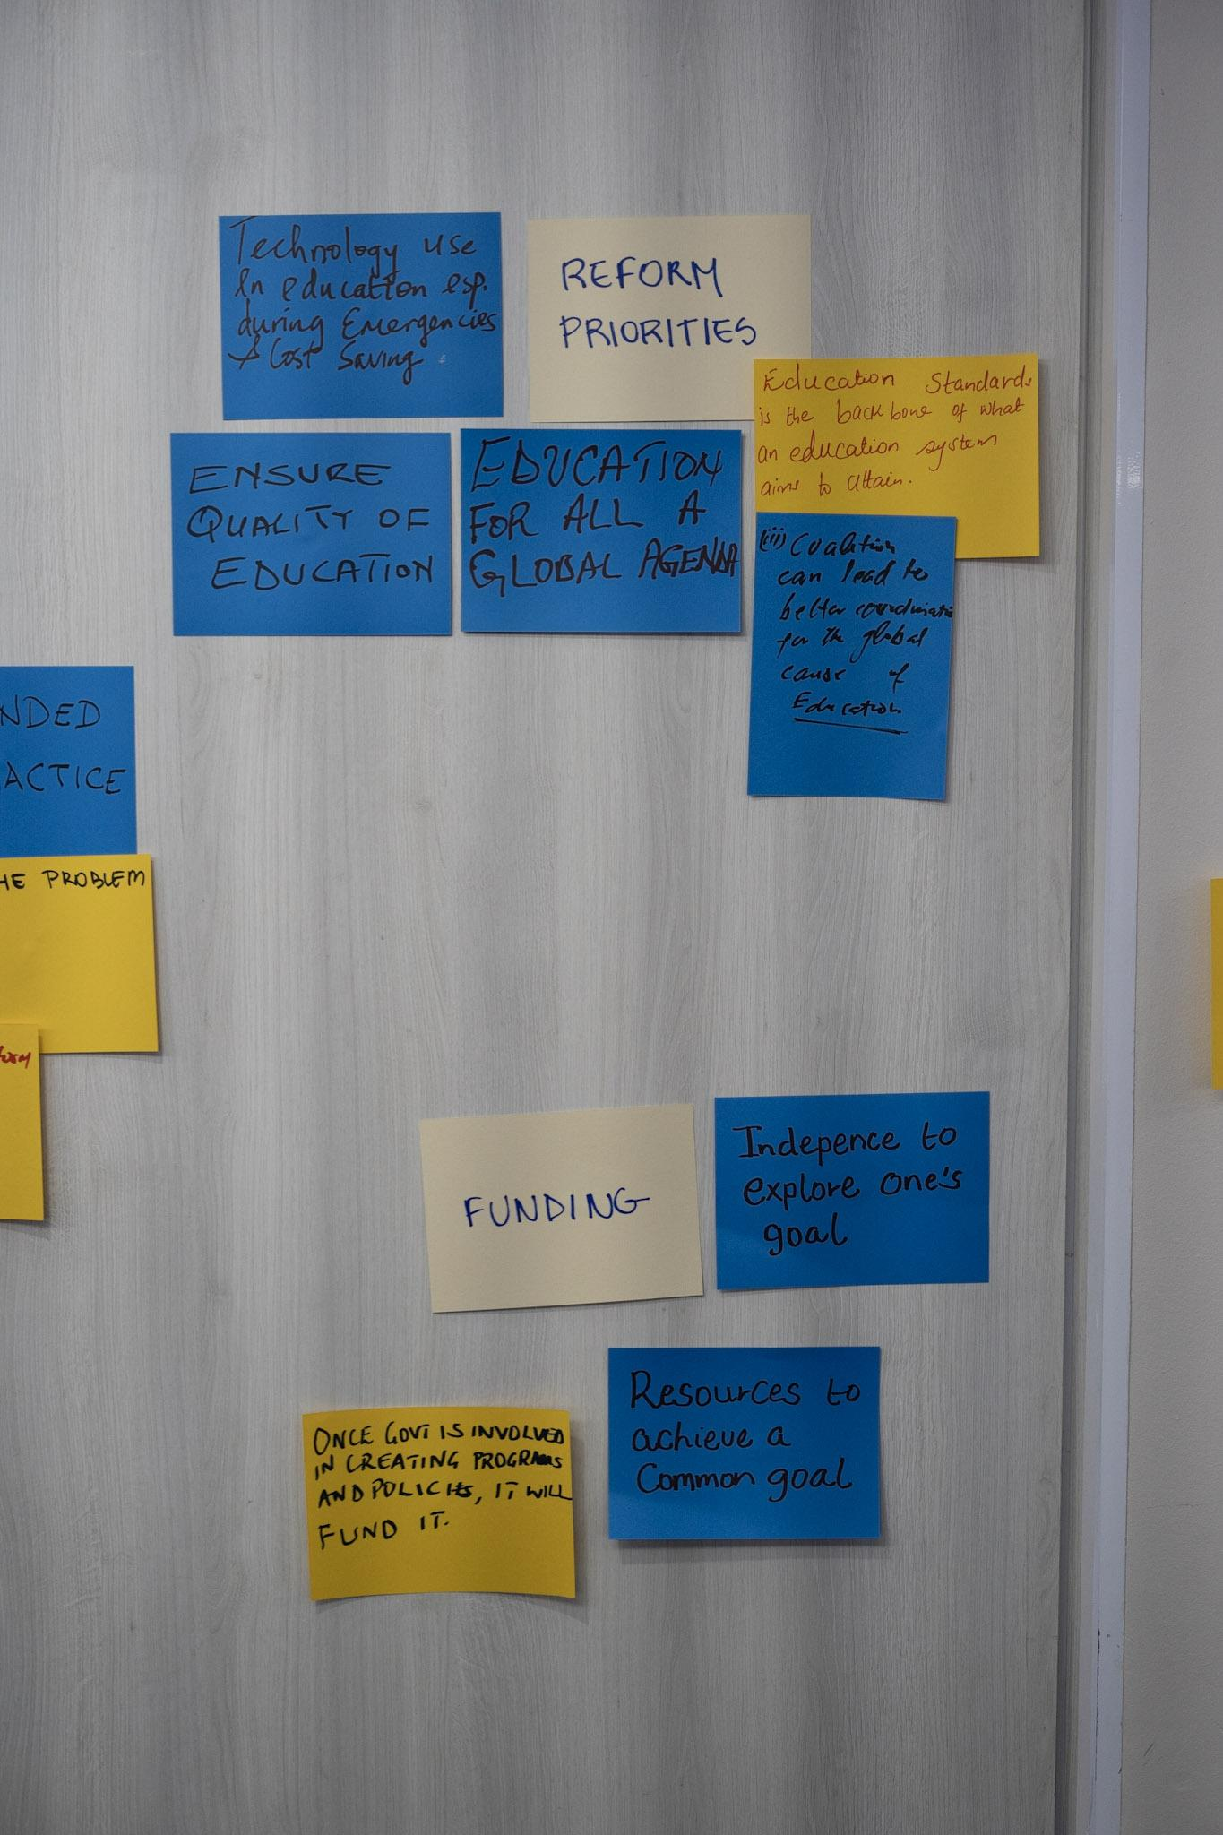
Notes:
Objectives are clear, relevant and feasible? Contents and methodological approach are aligned with objectives?

Slide 9
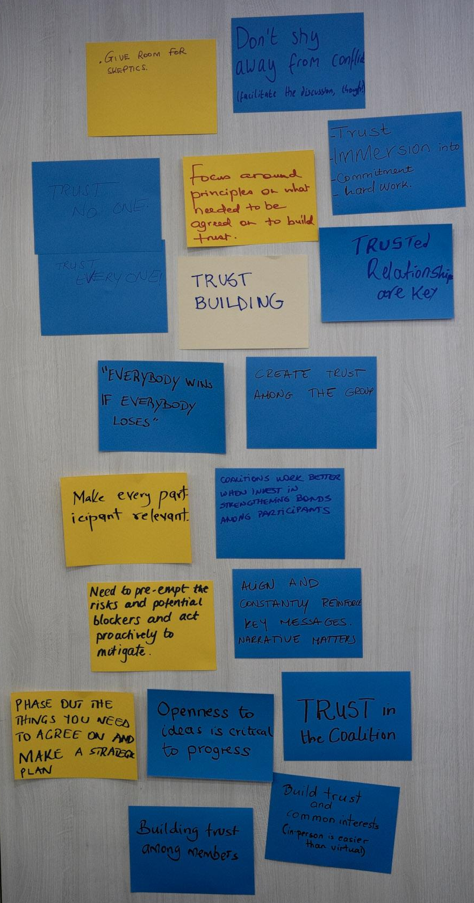
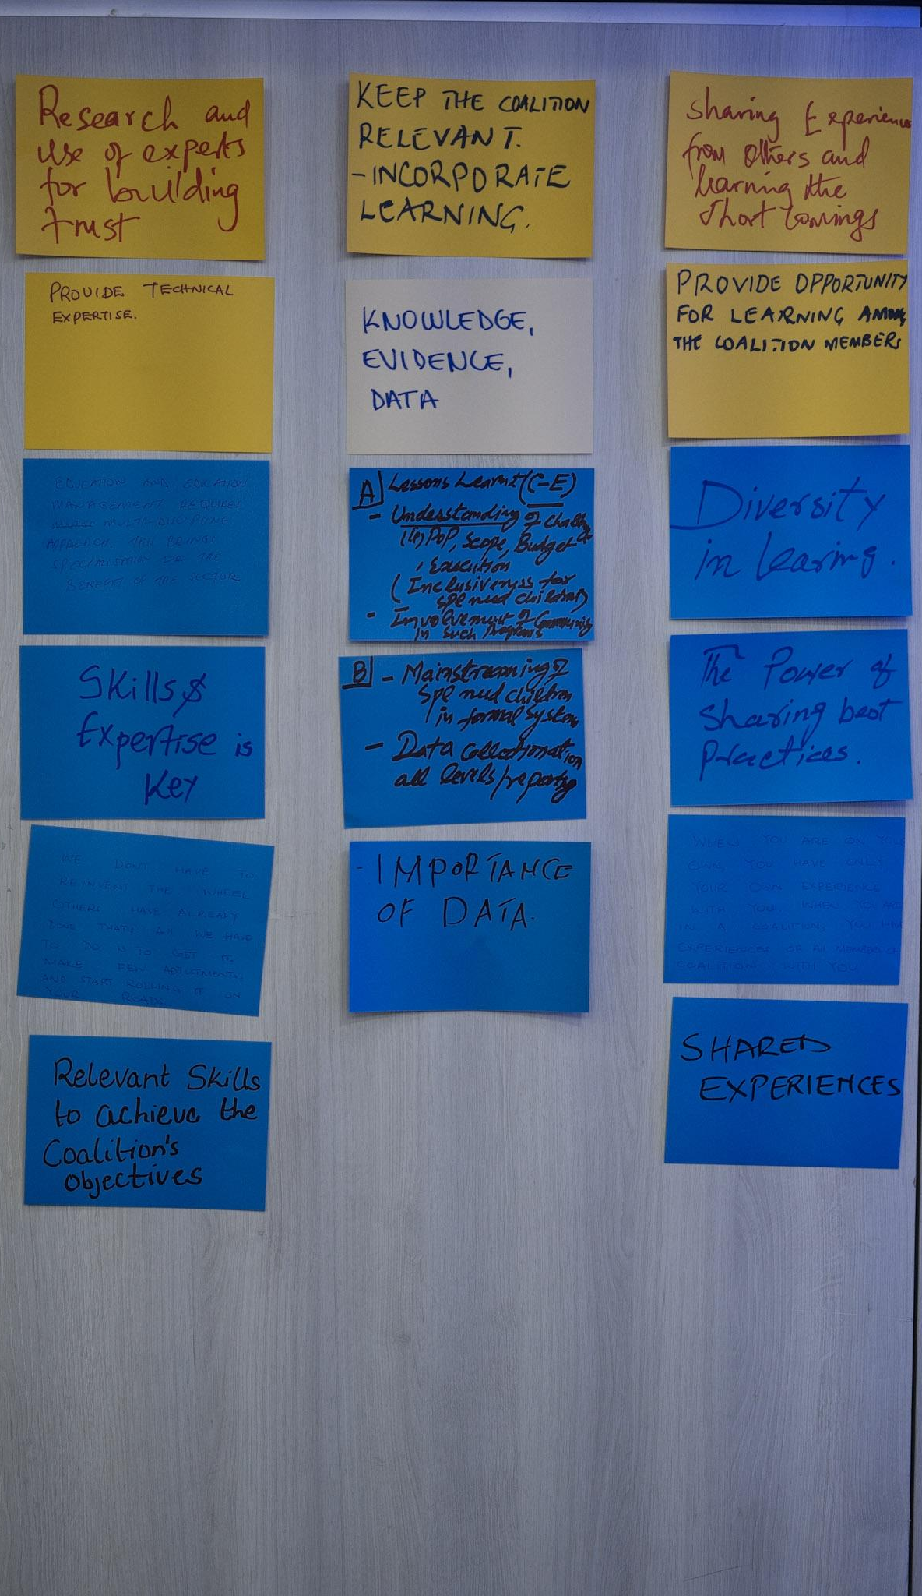
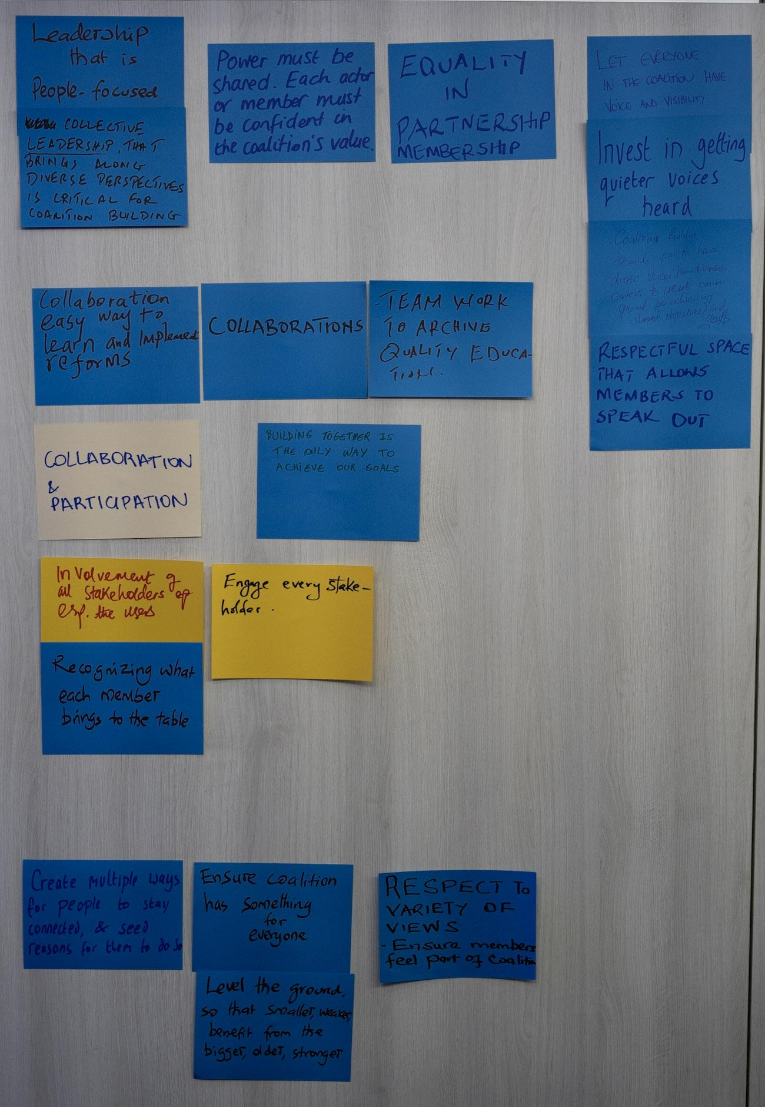
Notes:
Objectives are clear, relevant and feasible? Contents and methodological approach are aligned with objectives?

Slide 10
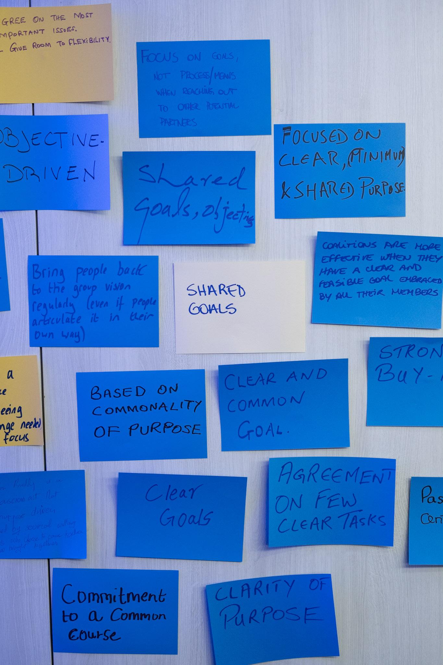
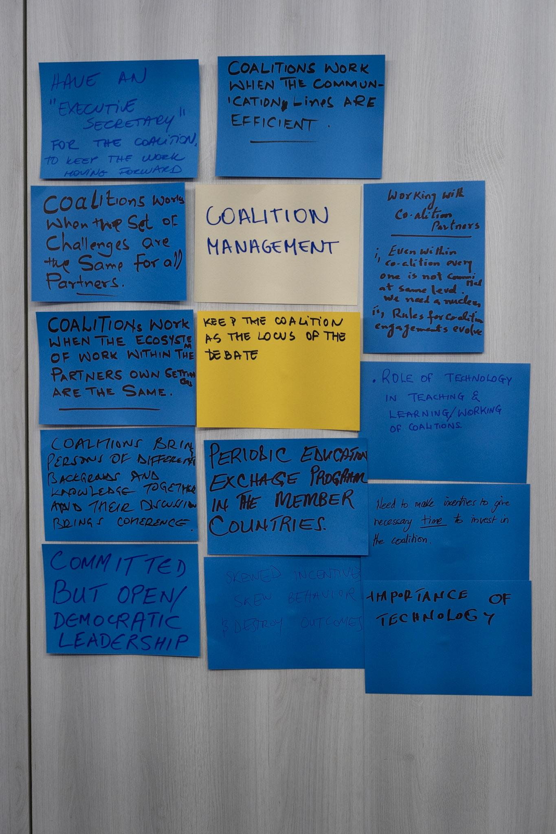
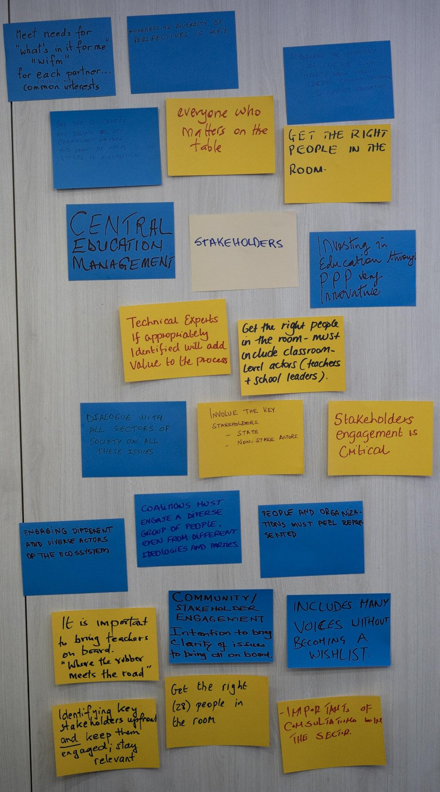

Slide 11
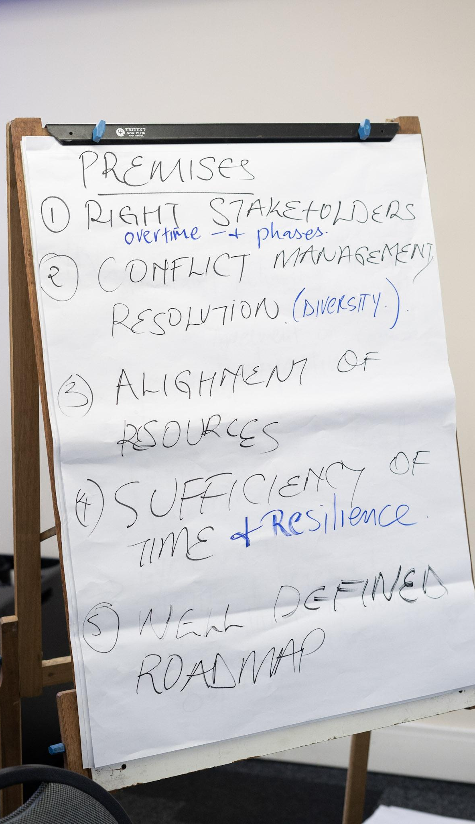
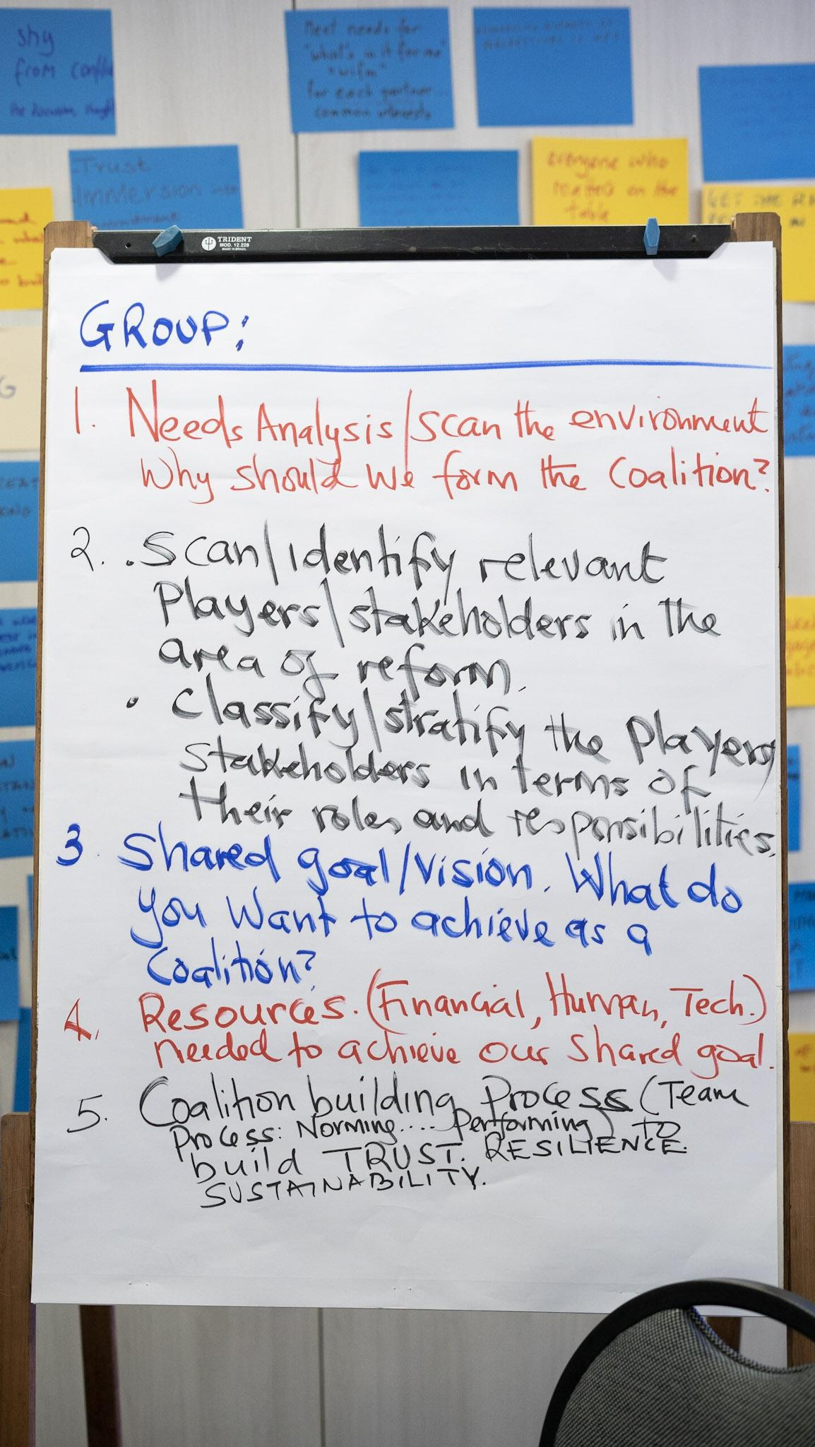
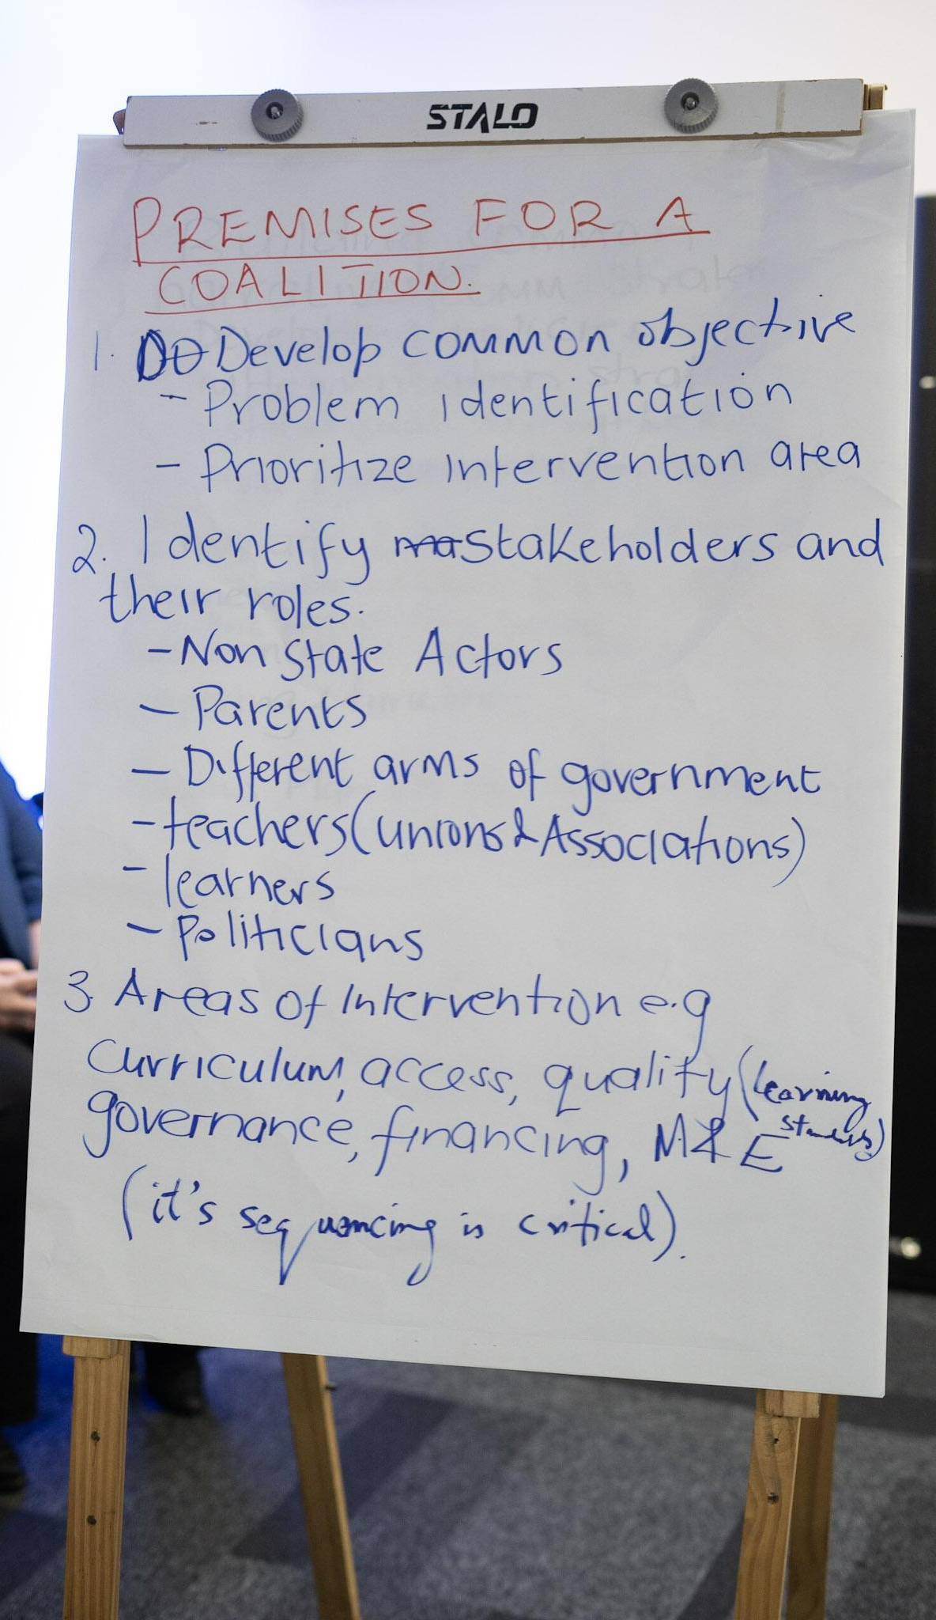

Slide 12
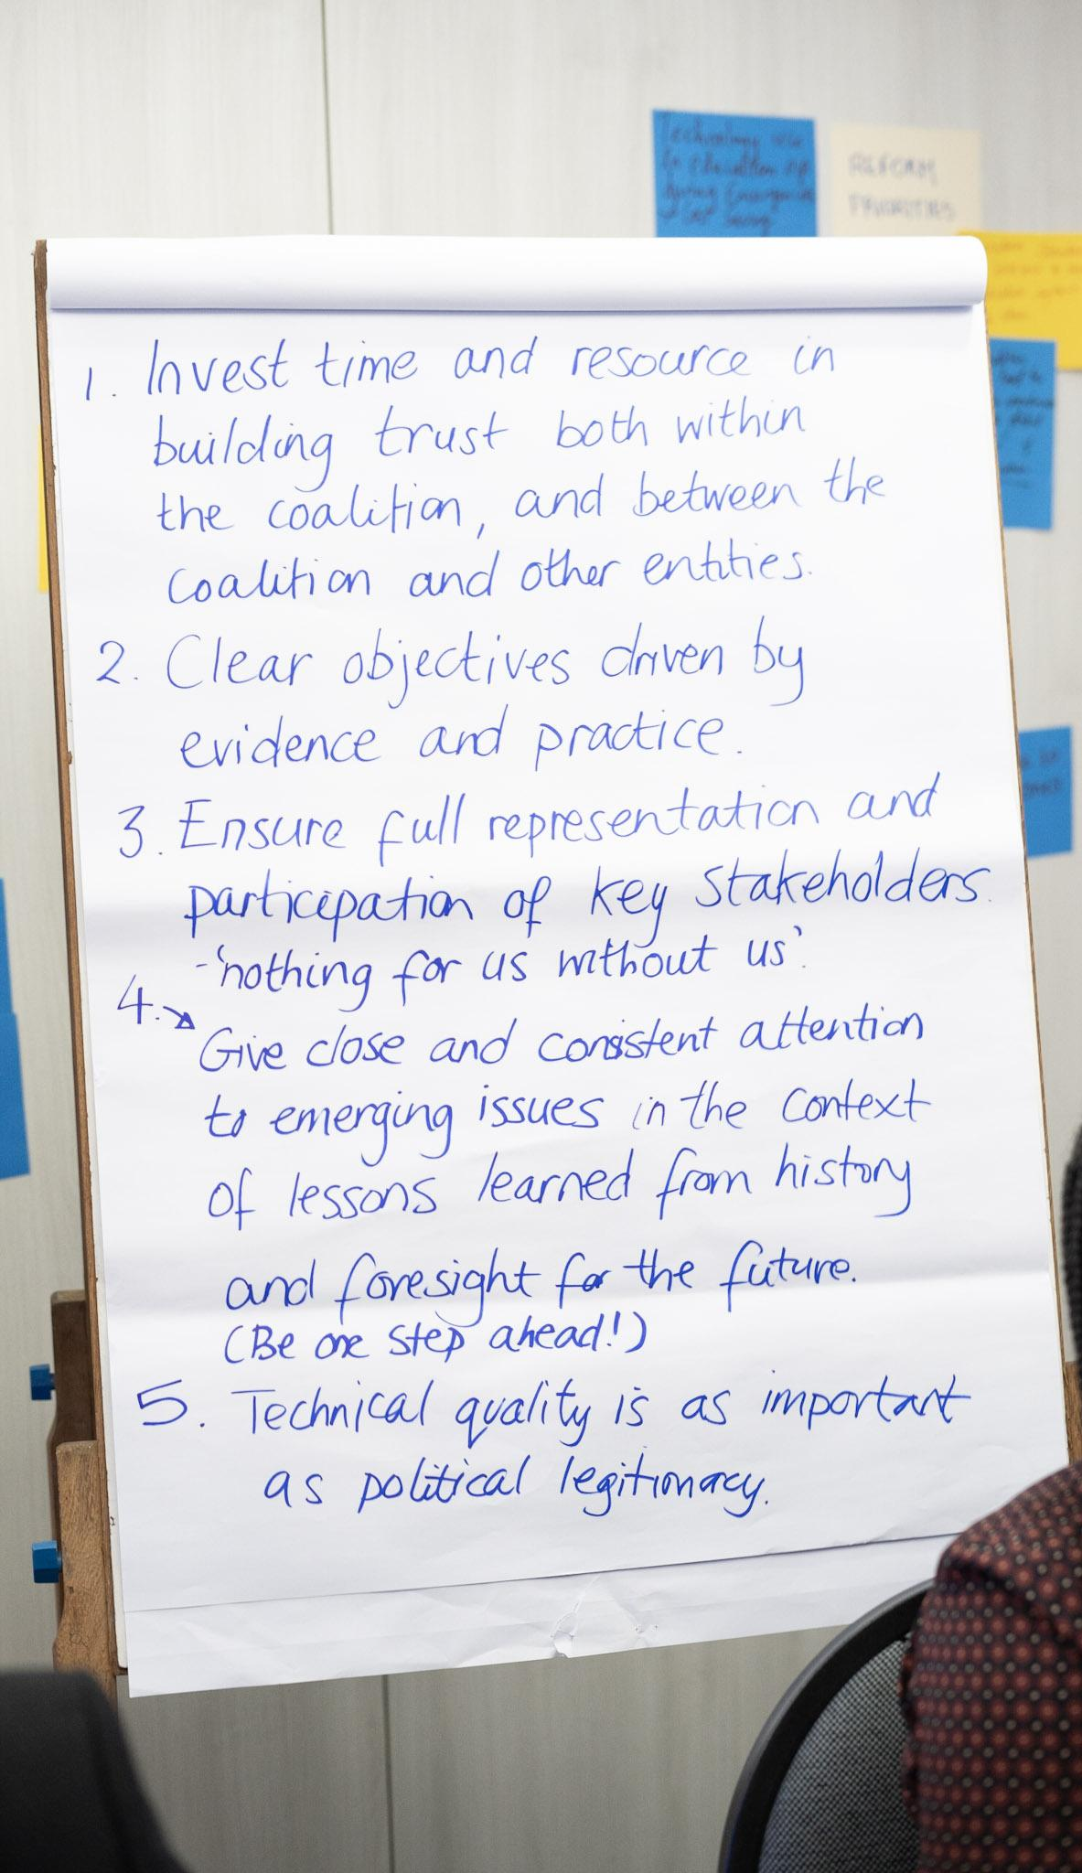
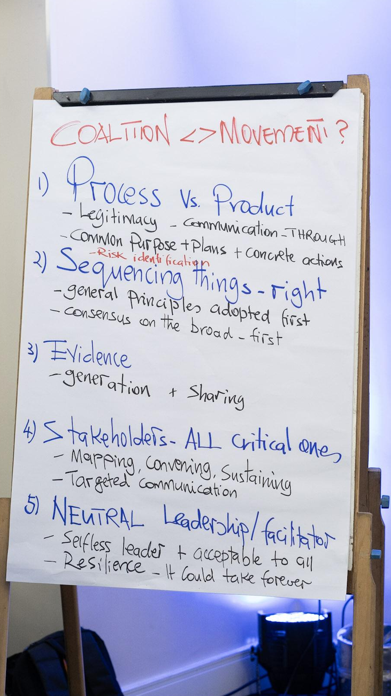
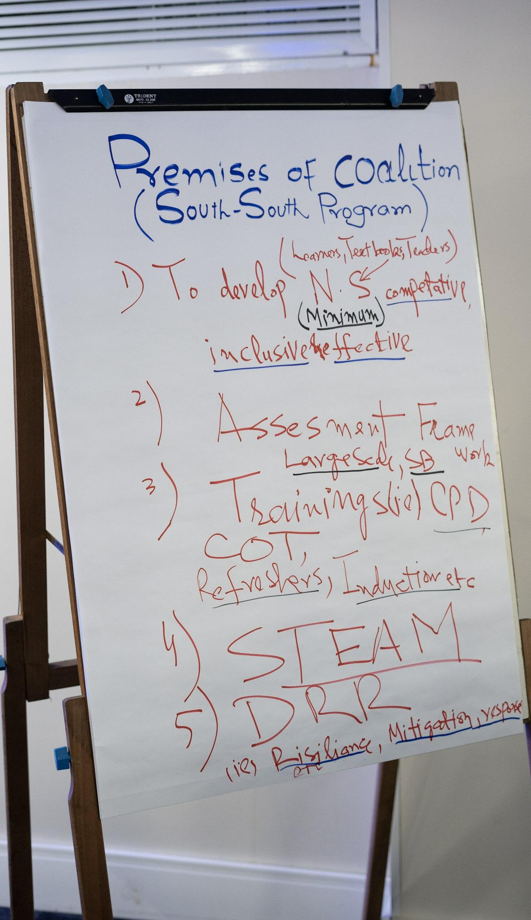

Slide 13
GUIDING PREMISES FOR BUILDING NATIONAL COALITIONS FOR EDUCATION REFORMS
1 Share power among all coalition members | 2 Build trust among coalition members | 3 Have a clear, common goal and a compelling narrative about it | 4 Map and engage all key stakeholders
5 Seek political legitimacy even in times of political change | 6 Use the knowledge & skills of the coalition members | 7 Create a solid plan, phasing decisions and reforms | 8 Establish a structured governance for the coalition
9 Define roles & responsibilities within members of the coalition | 10 Create (the right) incentives for the coalition to keep moving forward | 11 Implement reforms, tracking learning progress (and know it will take a while)
Notes:
Objectives are clear, relevant and feasible? Contents and methodological approach are aligned with objectives?

Slide 14
GUIDING PREMISES FOR BUILDING NATIONAL COALITIONS FOR EDUCATION REFORMS
Composition and space for all
Composition of coalition and space for all members
Share power among all coalition members
Trust building
Shared goals and narratives
Coalition needs to be led by national leaders (not external actors)
Respect and value different perspectives
Ensure all members feel part/represented in the coalition
Have collective/ democratic leadership and equality among all members
Allow everyone in the coalition to have voice and visibility
Create a space in which all feel comfortable to speak out; get quieter voices heard
All members should see the coalition’s value
The coalition should see the value of each member
Ensure coalition has something from everyone and for everyone
Stakeholder engagement
Political legitimacy
Collective knowledge & skills
Planning
Coalition management
Implementation & sustainability
Notes:
Objectives are clear, relevant and feasible? Contents and methodological approach are aligned with objectives?

Slide 15
GUIDING PREMISES FOR BUILDING NATIONAL COALITIONS FOR EDUCATION REFORMS
Composition and space for all
Trust building
Build trust among coalition members
Trust building
Shared goals and narratives
Building trust among members is key
Invest in strengthening members’ bonds
The lower the formality, the greater the trust
Building trust in-person is easier than virtually
Don't shy away from conflict: manage and facilitate them
Have room for sceptics
Guiding principles are important to build trust
Transparency & accountability are important to build trust
Stakeholder engagement
Political legitimacy
Collective knowledge & skills
Planning
Coalition management
Implementation & sustainability
Notes:
Objectives are clear, relevant and feasible? Contents and methodological approach are aligned with objectives?

Slide 16
GUIDING PREMISES FOR BUILDING NATIONAL COALITIONS FOR EDUCATION REFORMS
Composition and space for all
Shared goal and narratives
Have a clear, common goal and a compelling narrative about it
Trust building
Shared goals and narratives
The coalition should be purpose-driven: it should have a clear, common goal
Scan the environment and identify critical problems
Everybody wins if everybody loses:
  Setting a common goal is about compromise, finding common ground;
  To include different voices should not mean that the goal becomes a wishlist
Goal has to be embraced by all members
Goal should be based on evidence and practice
Goal setting should be donor independent
Align and constantly reinforce key messages
Narrative matters
Bring people back to the vision regularly
Stakeholder engagement
Political legitimacy
Collective knowledge & skills
Planning
Coalition management
Implementation & sustainability
Notes:
Objectives are clear, relevant and feasible? Contents and methodological approach are aligned with objectives?

Slide 17
GUIDING PREMISES FOR BUILDING NATIONAL COALITIONS FOR EDUCATION REFORMS
Composition and space for all
Stakeholder engagement
Map and engage all key stakeholders
Trust building
Shared goals and narratives
Engaging all key stakeholders is critical
Map key stakeholders and their roles & responsibilities
Bring stakeholders to the table early on
Engage diverse actors and sectors of the ecosystem
Mobilise strong support for your cause
Ensure representation and participation of stakeholders
Created targeted communication for the different stakeholders
Build trust with key stakeholders
Focus on goals, not on process when engaging stakeholders
Keep stakeholders engaged to stay relevant
Value and make use of the expertise coming from the different sectors
Coalitions must engage different ideologies and parties
Stakeholder engagement
Political legitimacy
Collective knowledge & skills
Planning
Coalition management
Implementation & sustainability
Notes:
Objectives are clear, relevant and feasible? Contents and methodological approach are aligned with objectives?

Slide 18
GUIDING PREMISES FOR BUILDING NATIONAL COALITIONS FOR EDUCATION REFORMS
Composition and space for all
Political legitimacy
Seek political legitimacy even in times of political change
Trust building
Shared goals and narratives
Technical quality and political legitimacy are equally important
Political will is important
Create strategies to be able to survive political change
Stakeholder engagement
Political legitimacy
Collective knowledge & skills
Planning
Coalition management
Implementation & sustainability
Notes:
Objectives are clear, relevant and feasible? Contents and methodological approach are aligned with objectives?

Slide 19
GUIDING PREMISES FOR BUILDING NATIONAL COALITIONS FOR EDUCATION REFORMS
Composition and space for all
Collective knowledge & skills
Use the knowledge & skills of the coalition members
Trust building
Shared goals and narratives
Skills and expertise are key to achieve the coalition’s goals
You have the experience of all members to achieve the goals
The coalition should create opportunity for all members to share their experience and learn from one another
Adapt successful cases to your reality (instead of ‘reinventing the wheel’)
Value and make use of the different types of expertise
Stakeholder engagement
Political legitimacy
Collective knowledge & skills
Planning
Coalition management
Implementation & sustainability
Notes:
Objectives are clear, relevant and feasible? Contents and methodological approach are aligned with objectives?

Slide 20
GUIDING PREMISES FOR BUILDING NATIONAL COALITIONS FOR EDUCATION REFORMS
Composition and space for all
Planning
Create a solid plan, phasing decisions and reforms
Trust building
Shared goals and narratives
The use evidence when defining goals and plan increase stakeholders’ acceptance
Phase coalition decisions
Prioritise the reforms and come to a roadmap
Phase the reforms; the sequencing of them is critical
Create a balance between quick wins and long-term transformations
Anticipate risks and act proactively to mitigate
Be flexible to adjust plans
Agree on clear indicators of success, without room for misunderstandings
Plan should include advocacy, evidence, action, research, and policymaking (all driven by monitoring, evaluation, and learning)
Plan the implementation early on
Stakeholder engagement
Political legitimacy
Collective knowledge & skills
Planning
Coalition management
Implementation & sustainability
Notes:
Objectives are clear, relevant and feasible? Contents and methodological approach are aligned with objectives?

Slide 21
GUIDING PREMISES FOR BUILDING NATIONAL COALITIONS FOR EDUCATION REFORMS
Composition and space for all
Coalition management
Establish a structured governance for the coalition
Define roles & responsibilities within members of the coalition
Create (the right) incentives for the coalition to keep moving forward
Trust building
Shared goals and narratives
Stakeholder engagement
Coalitions work when the communication lines are efficient
Have an ‘executive secretary’/ neutral leader/ facilitator of the coalition to keep it moving forward (reforms take a long time)
  Should be accepted by all
Have incentives so that members invest the necessary time in the coalition
  But have the right incentives, skewed incentives can be detrimental
Accept that not all coalition members will be equally committed
Have strong mutual accountability
Have the resources for the coalition work: financial, human, technological etc.
Political legitimacy
Collective knowledge & skills
Planning
Coalition management
Implementation & sustainability
Notes:
Objectives are clear, relevant and feasible? Contents and methodological approach are aligned with objectives?

Slide 22
GUIDING PREMISES FOR BUILDING NATIONAL COALITIONS FOR EDUCATION REFORMS
Composition and space for all
Reform implementation & sustainability
Implement reforms, tracking learning progress (and know it will take a while)
Trust building
Shared goals and narratives
The heaviest work is implementation, give it enough time and have resilience
Keep engaged:
  Coalition members – this is hard work
  Stakeholders
  Political stakeholders throughout the political cycles
Create strategies to be able to survive political change
Use lessons and tendencies for the future to adjust and improve plan (be one step ahead!)
Once government is involved in creating programmes and policies, it will fund them
Use assessments to track progress and generate evidence
Change the legal framework to ensure sustainability of the changes
Stakeholder engagement
Political legitimacy
Collective knowledge & skills
Planning
Coalition management
Implementation & sustainability
Notes:
Objectives are clear, relevant and feasible? Contents and methodological approach are aligned with objectives?

Slide 23
LOOKING AHEAD
The Fellowship Programme is coming to an end, but the
South-South work continues
COALITIONS IN PAKISTAN AND KENYA
TRANSNATIONAL NETWORK
GLOBAL PUBLIC GOODS
Notes:
Objectives are clear, relevant and feasible? Contents and methodological approach are aligned with objectives?

Slide 24
TRANSNATIONAL NETWORK
How we can continue to have education exchange through a transnational network::
FELLOWS’ INPUT FROM DISCUSSIONS IN COP#5
Objectives of keeping connected:
To share & learn To share and learn evidence, experiences, best practices (in foundational learning) To share the work in Kenya and Pakistan To curate knowledge | To develop To develop professionally | To collaborate To brainstorm solutions to common challenges (e.g. political challenges) To enable more collaboration between education orgs./ actors | To align To help group see the ‘bigger picture’ To create more alignment within the education sector (as well as more efficient use of resources) | To expand network To expand network to other countries To create a global movement for foundational learning
Notes:
Objectives are clear, relevant and feasible? Contents and methodological approach are aligned with objectives?

Slide 25
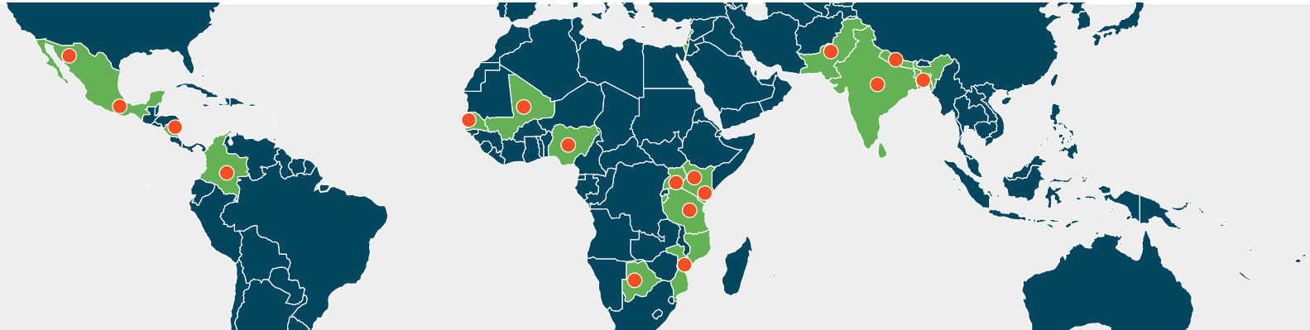

TRANSNATIONAL NETWORK
FELLOWS’ INPUT FROM DISCUSSIONS IN COP#5
PAL Network was the most voted choice in all groups
  Global reach
  Opportunity to exchange with other countries
  Good fit for the objectives of both coalitions, in Pakistan and Kenya
  Interesting impact (e.g. in policy dialogue)
Notes:
Objectives are clear, relevant and feasible? Contents and methodological approach are aligned with objectives?

Slide 26
TRANSNATIONAL NETWORK
FELLOWS’ INPUT FROM DISCUSSIONS IN COP#5
Activities the fellows would be interested in:
  Written materials (e.g. case studies)
  Conferences
  Meetings
  Learning visits
  Collaborative advocacy
  Collaborative research
  1:1 exchange
  Exchanges (working abroad for some time)
  Online forums
Content the fellows would be interested in:
  Fundraising opportunities
  Other type of opportunities
  Assessment: tools, frameworks
  M&E
  Education funding
  Technology in education
  Equity/ inclusion in education
  Training for headteachers & teachers
  Content/ resources for headteachers & teachers (especially digital)
Notes:
Objectives are clear, relevant and feasible? Contents and methodological approach are aligned with objectives?

Slide 27
LOOKING AHEAD
The Fellowship Programme is coming to an end, but the
South-South work continues
COALITIONS IN PAKISTAN AND KENYA
TRANSNATIONAL NETWORK
GLOBAL PUBLIC GOODS

Slide 28







GLOBAL PUBLIC GOODS
How we can use and share evidence, practices, and lessons about coalitions, education reforms, and foundational learning:
We produced a set of Global Public Goods that approach local experiences and that can serve as conversation starters for education policymakers in the Global South
We based their selection and content based on your inputs and feedbacks
Case studies | Podcasts | Discursive learning documents | Videos
Brazil: The Movement for the National Learning Standards
The education revolution in Sobral
Pakistan: The experience of Public-Private Partnerships (PPPs) in the province of Sindh
Kenya: Literacy and numeracy initiatives Tusome/PRIEDE in Kenya

Slide 29
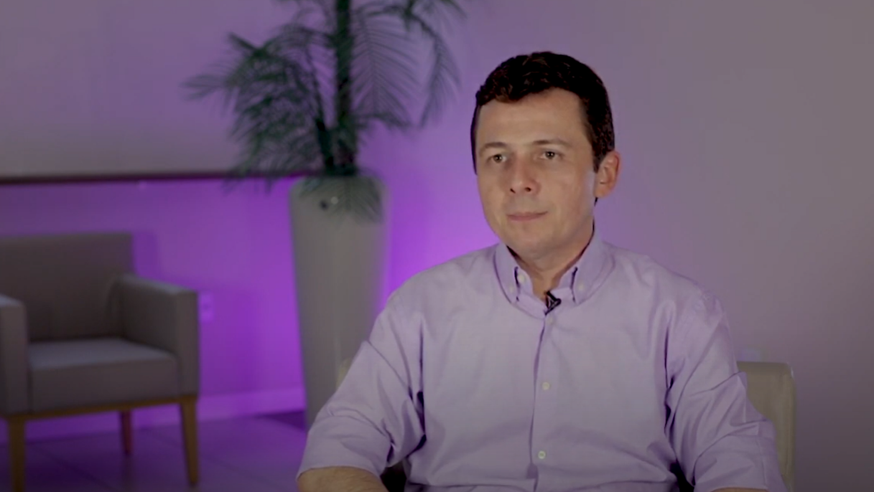
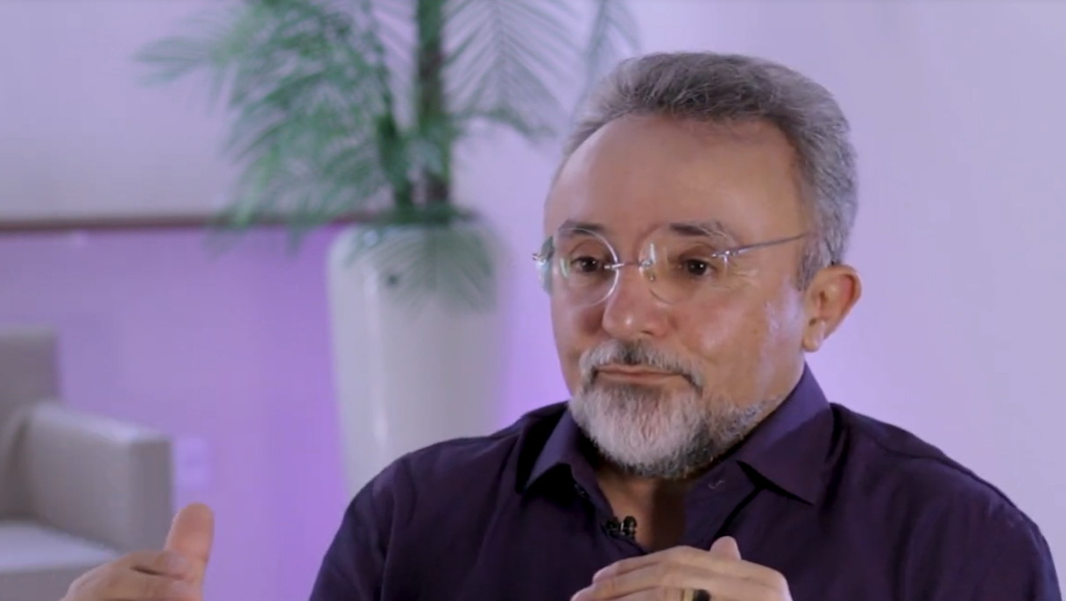
GLOBAL PUBLIC GOODS
We are creating a set of videos that explain the main public policies implemented in Sobral that led to its extraordinary results.
They are based on interviews with policymakers, headteachers, and teachers from Sobral
They encompass the policies since the beginning of the education revolution
Topics of the videos:
  School leadership for the strengthening of the pedagogical management
  Access and permanence of students
  Assessment and management of goals & results
  Teacher training for the strengthening of the teaching practice
  Teaching materials and pedagogical management
Release of the videos in Apr/23

Slide 30
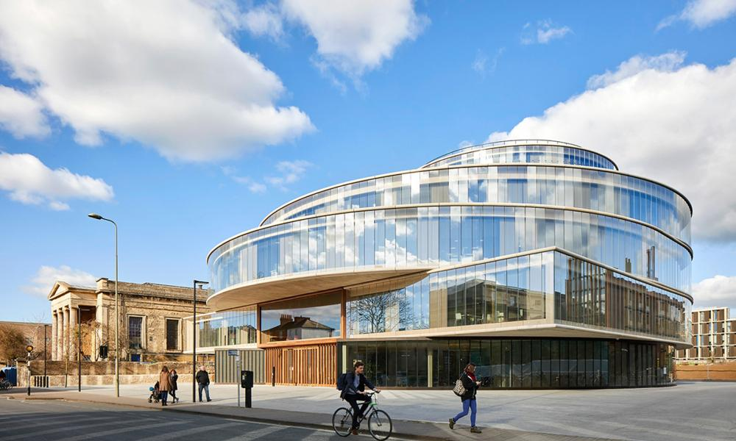

GLOBAL PUBLIC GOODS
Global Public Goods will be freely available to for a global audience through a Library of Global Public Goods
Our goal is that they equip education leaders all over the Global South to lead coalitions and reforms in their countries
We want our transnational network to help us mobilise a broad use of them
Please use them yourselves and share them with other education leaders you know!
The launch event of the Library of Global Public Goods will happen on
11 May – save the date!
Notes:
Objectives are clear, relevant and feasible? Contents and methodological approach are aligned with objectives?

Slide 31
Coalitions’ status and priorities: KENYA

Slide 32
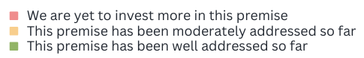
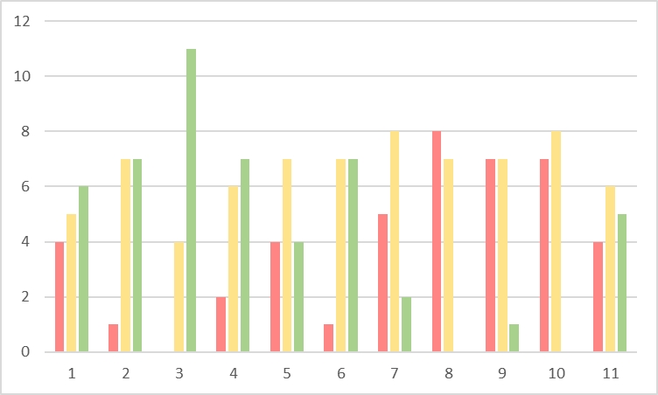
KENYA: FELLOWS’ ANALYSIS OF THE COALITION STATUS AND PRIORITIES
We had a total of 15 answers.
1- Share power among all coalition members
2- Build trust among coalition members
3- Have a clear, common goal and a compelling narrative about it
4- Map and engage all key stakeholders
5- Seek political legitimacy even in times of political change
6- Use the knowledge & skills of the coalition members
7- Create a solid plan, phasing decisions and reforms
8- Establish a structured governance for the coalition
9- Define roles & responsibilities within members of the coalition
10- Create (the right) incentives for the coalition to keep moving forward
11- Implement reforms, tracking learning progress (and know it will take a while)
Number of answers
Premise
Notes:
Objectives are clear, relevant and feasible? Contents and methodological approach are aligned with objectives?

Slide 33
KENYA: FELLOWS’ ANALYSIS OF THE COALITION STATUS AND PRIORITIES
Suggestion of other premises:
Create awareness of the coalition activities to relevant government actors (connected to Premise #4 - Map and engage all key stakeholders)
Engage political parties to yield best results and sustain initiatives (connected to Premises #4 - Map and engage all key stakeholders and #5 - Seek political legitimacy even in times of political change)
Have a proper line of communication (connected to Premise #8 - Establish a structured governance for the coalition)
Schedule time for coalition meetings at a given interval (connected to Premise #8 - Establish a structured governance for the coalition)
Notes:
Objectives are clear, relevant and feasible? Contents and methodological approach are aligned with objectives?

Slide 34
Coalitions’ status and priorities: PAKISTAN

Slide 35
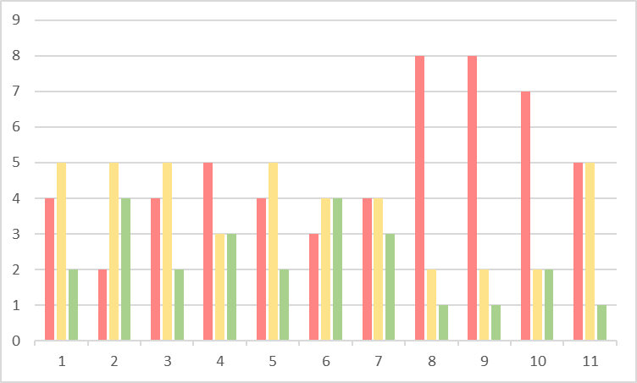
PAKISTAN: FELLOWS’ ANALYSIS OF THE COALITION STATUS AND PRIORITIES
We had a total of 11 answers.
1- Share power among all coalition members
2- Build trust among coalition members
3- Have a clear, common goal and a compelling narrative about it
4- Map and engage all key stakeholders
5- Seek political legitimacy even in times of political change
6- Use the knowledge & skills of the coalition members
7- Create a solid plan, phasing decisions and reforms
8- Establish a structured governance for the coalition
9- Define roles & responsibilities within members of the coalition
10- Create (the right) incentives for the coalition to keep moving forward
11- Implement reforms, tracking learning progress (and know it will take a while)
Number of answers
Premise
Notes:
Objectives are clear, relevant and feasible? Contents and methodological approach are aligned with objectives?

Slide 36
PAKISTAN: FELLOWS’ ANALYSIS OF THE COALITION STATUS AND PRIORITIES
Suggestion of other premises:
Create a business case (connected to Premise #3 - Have a clear, common goal and a compelling narrative about it)
Mobilise technical resources (connected to Premises #4 - Map and engage all key stakeholders and #6 - Use the knowledge & skills of the coalition members)
Mobilise financial resources (connected to Premise #11 - Implement reforms, tracking learning progress (and know it will take a while)
Notes:
Objectives are clear, relevant and feasible? Contents and methodological approach are aligned with objectives?

Slide 37
Results of the satisfaction survey

Slide 38
COP#6: RESULTS OF SATISFACTION SURVEY
Please find here the results of the satisfaction survey we shared at the end of the COP.
1 meant ‘Totally disagree’, and 5 meant ‘Totally agree’.
There were 19 answers.
 | The objectives of the session were met | The time was appropriate for the session | The content discussed during the session was useful | The session was interesting and engaging | The session was well planned and led | My questions have been solved | I felt comfortable in openly expressing my opinions during the session
Average score | 4.6 | 4.4 | 4.4 | 4.6 | 4.5 | 4.4 | 4.4
% of grades 4 or 5: | 90% | 84% | 84% | 95% | 85% | 90% | 84%
Notes:
Objectives are clear, relevant and feasible? Contents and methodological approach are aligned with objectives?

Slide 39
COP#6: RESULTS OF SATISFACTION SURVEY
Comments | Suggestions
"It was a nice exchange of comments and ideas during the session" "This is one of the most interactive program i have ever participated. " "This has been an amazing experience though i had challenges with network. The surprises were well thought out and i have enjoyed them. This COP#6 was a culmination and expression of very intense engagement for the last six months with memorable experiences. I do not have the words to express my gratitude to the partners, facilitators and the fellows for this amazing experience. " "It was my 1st session in which i enjoyed music and most important i saw that how my fellows learned from each other from Sobral Journey " "I was despairing because we haven't completed what we started. Today I am full of hope because the end of the programme is not the end of the coalition. I am more committed than before to make the coalition work and to ensure that all children in Kirinyaga are learning. Thank you for opening a world that I didn't know" "What an inspiring encounter I have had all this while! Thank you for the opportunity!" "The learning from Sobral will guide in sustaining education reforms.. " | "Interactions at individual level be continued in coming days. Experiences and contexts of all countries are different but people's aspirations are common to grow , to learn , to read , to write , to express for which the only way is quality schooling." "1. The session was magical especially the surprises were outstanding and curated with so much thought and love . We remain in a high gear learning mode no doubt and committed to System Transformation for Foundational Learning - inspired by Sobral as a brilliant space that showcased what a learning journey is all about and with so much respect. 2. The request is that a six or seven month engagement in such a Powerful Fellowship is too short- as the first cohort it does not do justice to the huge efforts of LEMANN Foundation and its amazing team leaders and coaches. Kudos to you and it is vital that the What Works Hub reconsider the duration.. and enables us to continue at least until September 2023 3. We thank our coaches, mentors and facilitator who were so brilliant and committed - you enabled us to embark on a journey of bonds for a purpose and we shall continue to multiply and reinvent ourselves until we achieve our collective mission All Children Learning up to Grade 3 in Pakistan .. starting small and gaining ground Inshallah" "There is need for gradual ending of the program say check-in after 3 months,six months then 12 months "

Slide 40
Thank you!

